Slide 1
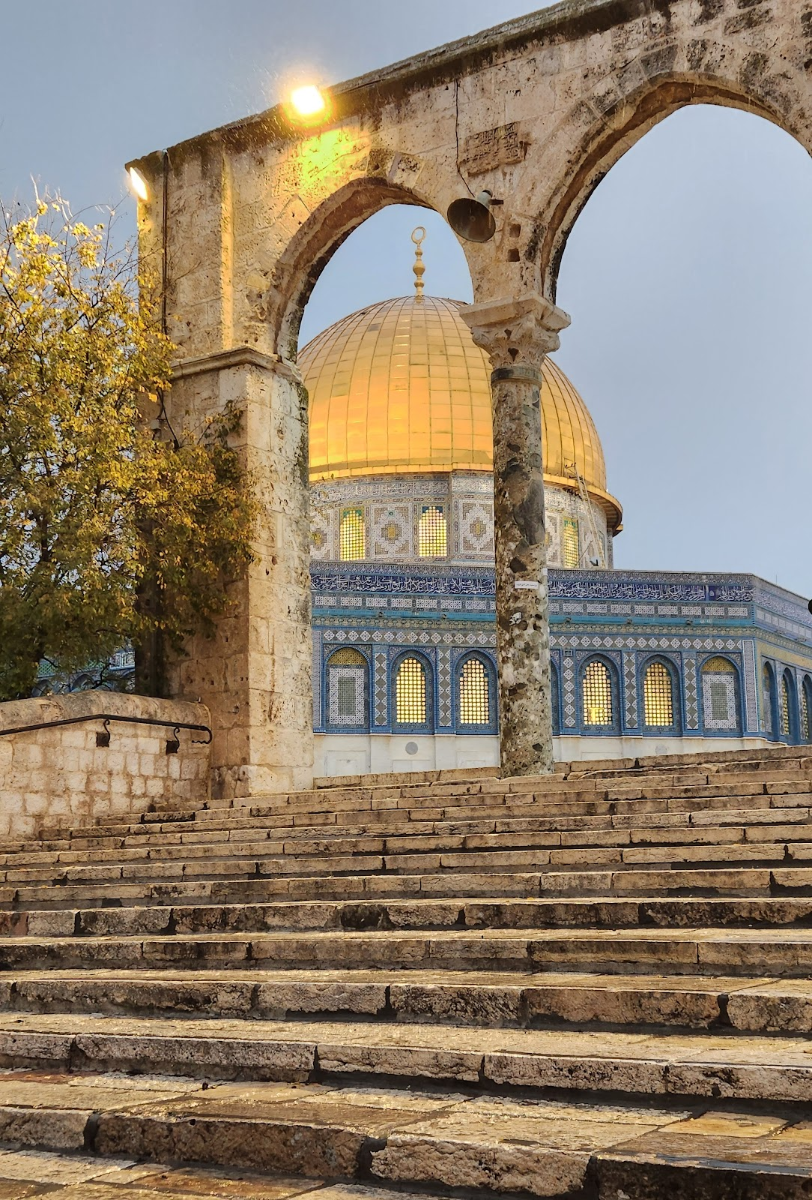
Masjid Al Aqsa – The blessed Sanctuary

Slide 2
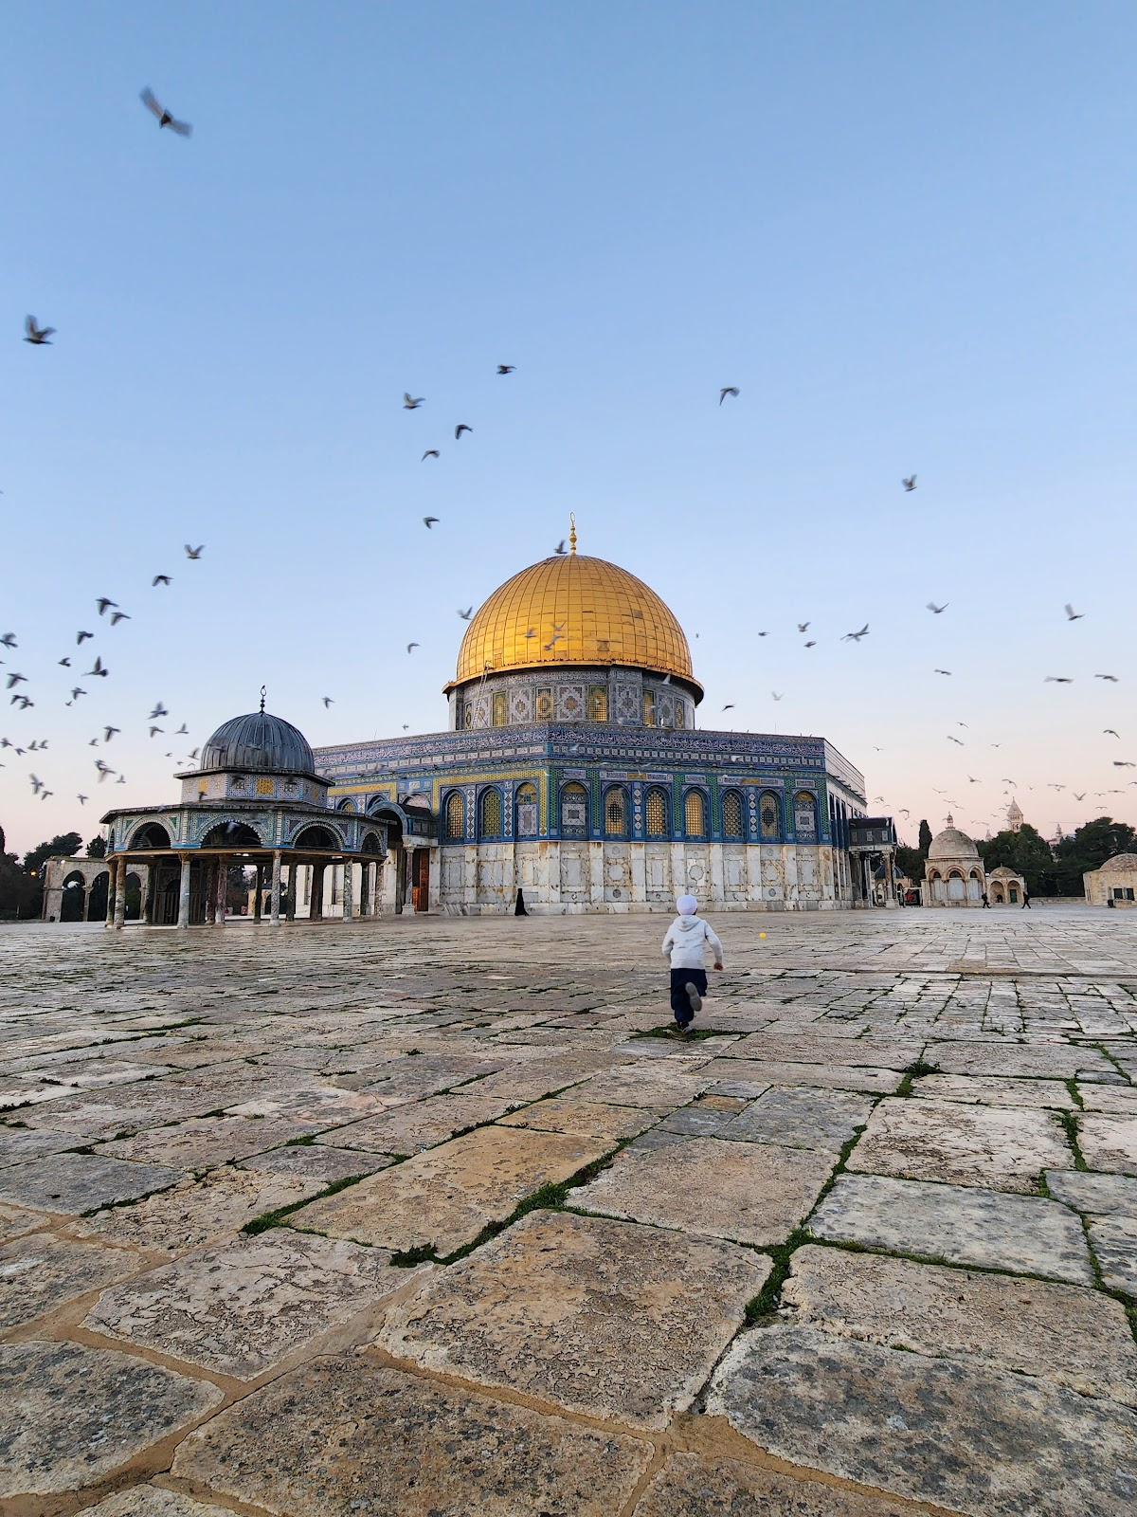
Virtues
It is with the intention to rekindle the love, affection and devotion of Muslims to Masjid Al-Aqsa that we are gathered here today.
Our Prophet (saw) showed such great concern and inculcated into the Companions the need to liberate Masjid Al-Aqsa and Jerusalem.
He once saw a companion Shaddad bin Aws in distress.

Slide 3
Virtues
Zaid Ibn Thabit (ra) reports that the Prophet (saw) said, “How blessed is Al-Sham”! The Companions (ra) asked, “Why is that”? The Messenger (saw) replied, “I see the Angels of Allah spreading their wings over Al-Sham”. Ibn Abbas (ra) added, “And the Prophets lived therein. There is not a single inch in Al-Quds (Jerusalem) where a Prophet has not prayed or an Angel not stood”. (Tirmidhi, Ahmad)

Slide 4
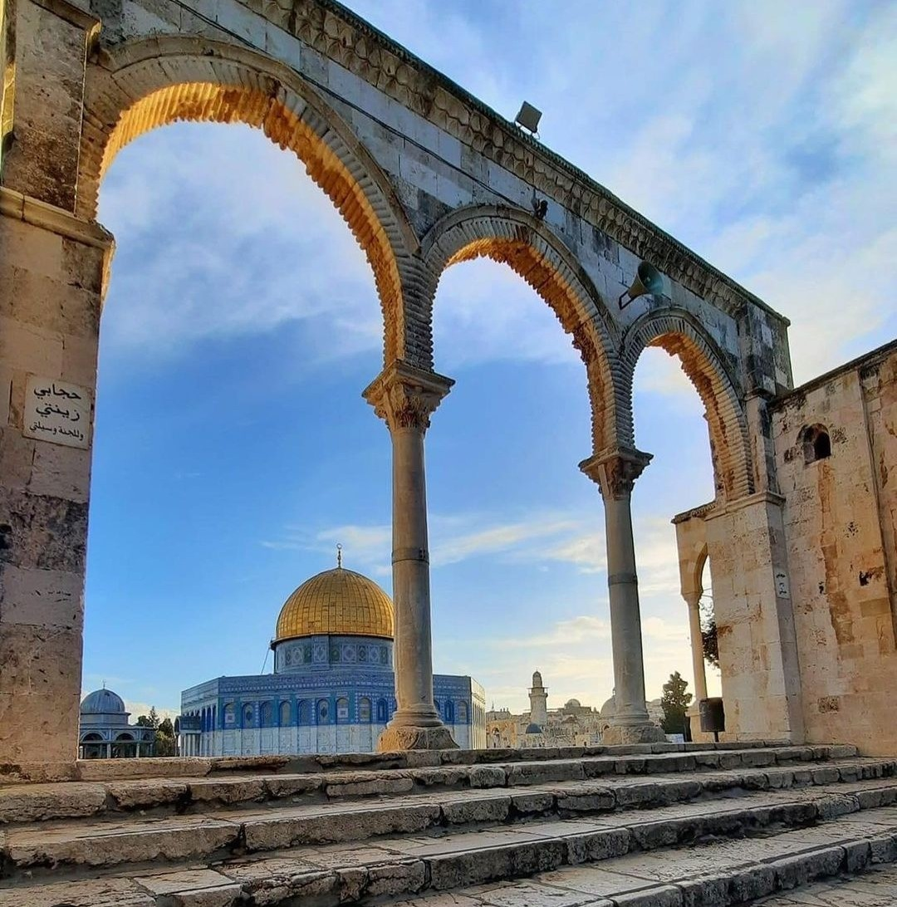
Virtues
Anas Ibn Malik (ra) relates that the Prophet (saw) said, ” The prayer of a person in his house is a single prayer; his prayer in the Masjid of his people has the reward of 27 prayers; his prayer in the Masjid in which the Friday prayer is observed has the reward of 500; his prayer in Masjid Al-Aqsa (i.e. Al-Aqsa Sanctuary) has a reward of 5,000 prayers; his prayer in my Masjid (the Prophet’s Masjid in Madinah) has a reward of 50,000 prayers, and the prayer in the Sacred Masjid (Ka’bah) has the reward of 100,000 prayers”. (Tirmidhi, Ibn Majah)

Slide 6
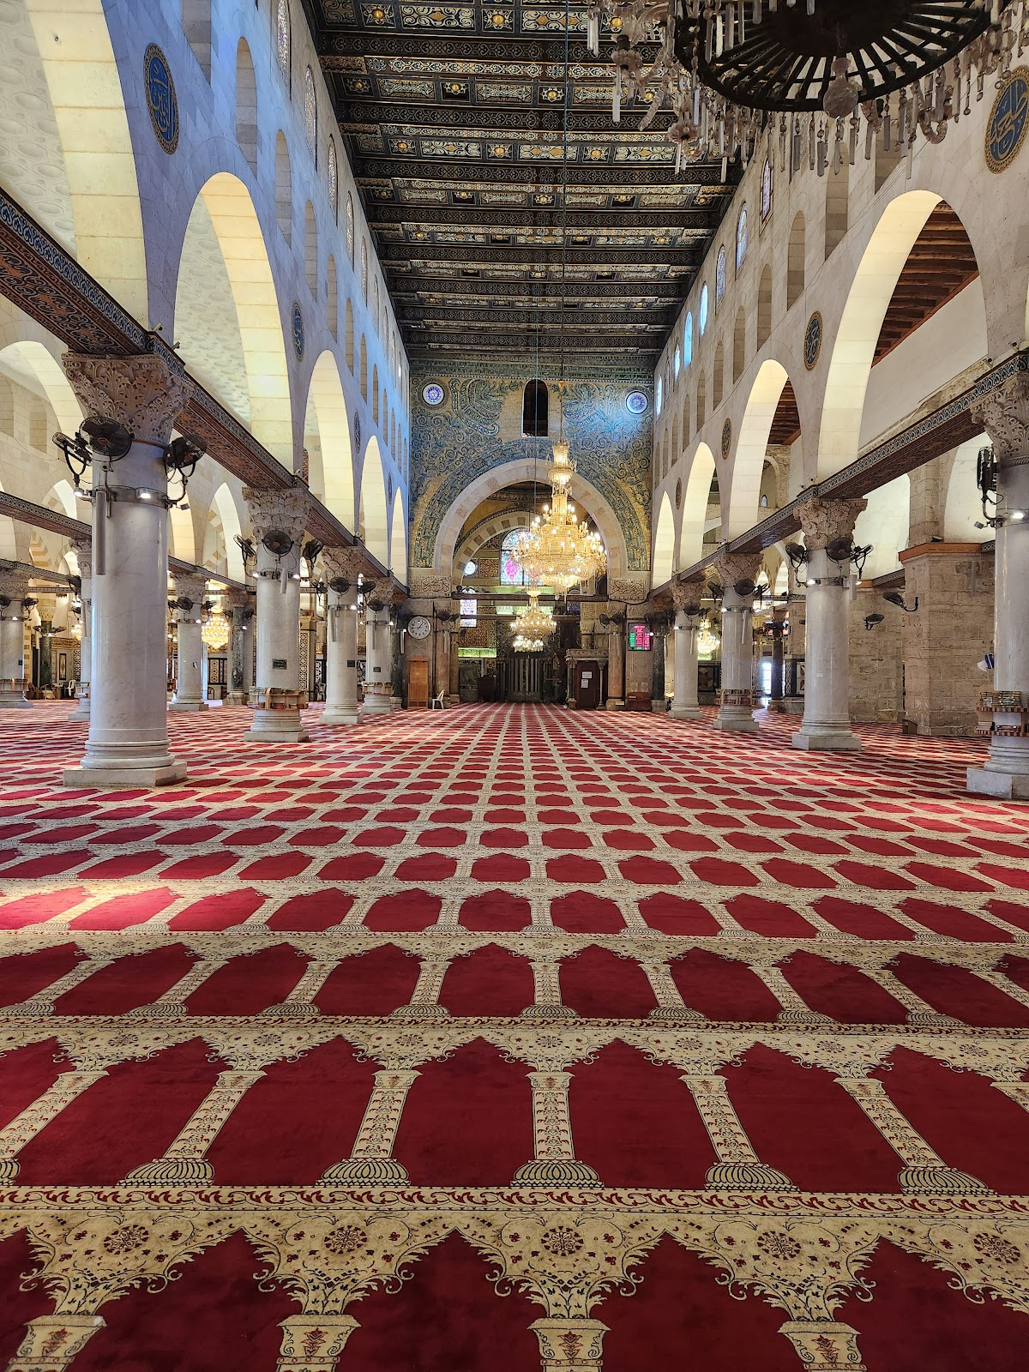
The interior of Masjid Al Qibly within the Al Aqsa Compound.
The Messenger of Allah (saw) said regarding the inhabitants of the blessed land, “They and their wives, children are in ribat (guardians, literally a fort) in the cause of Allah”. (Tabarani)

Slide 7
Prophet Muhammad SAW

Slide 8
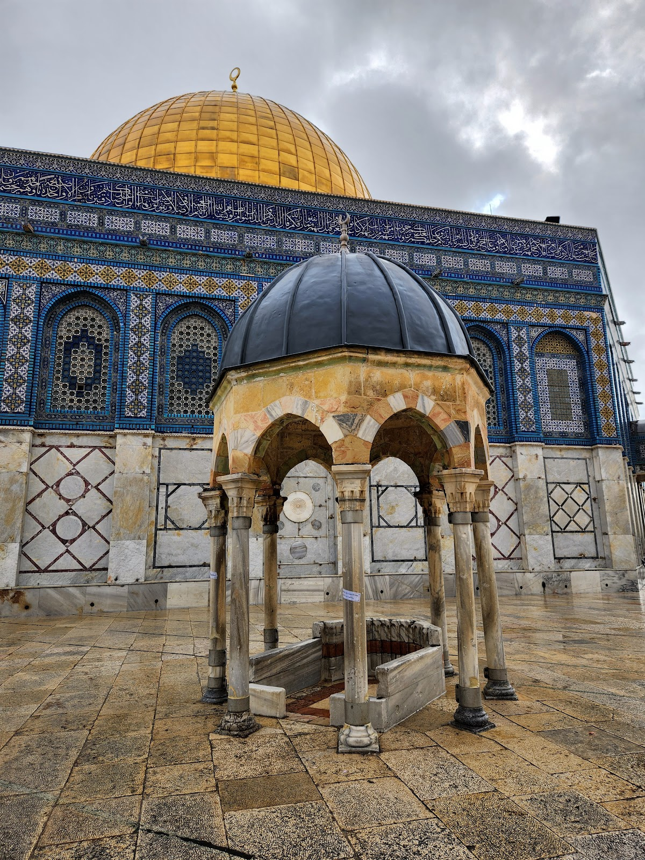
The only place on earth where all the Messengers of Allah prayed at the same time led by the Mohammed (saw)

Slide 9
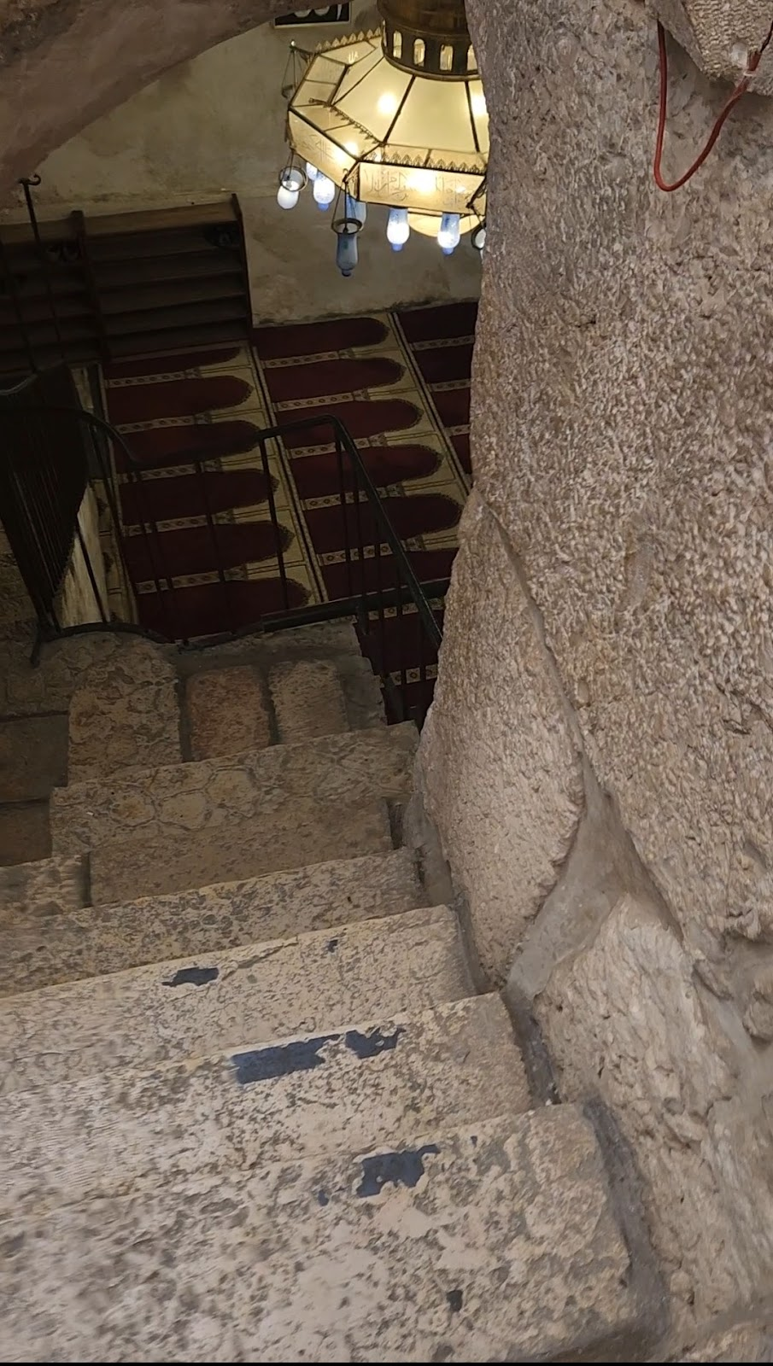
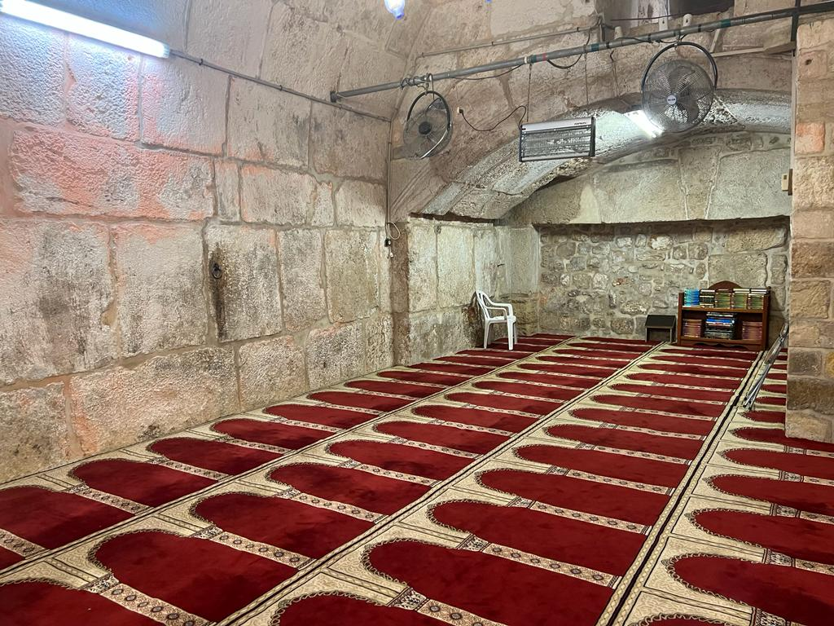
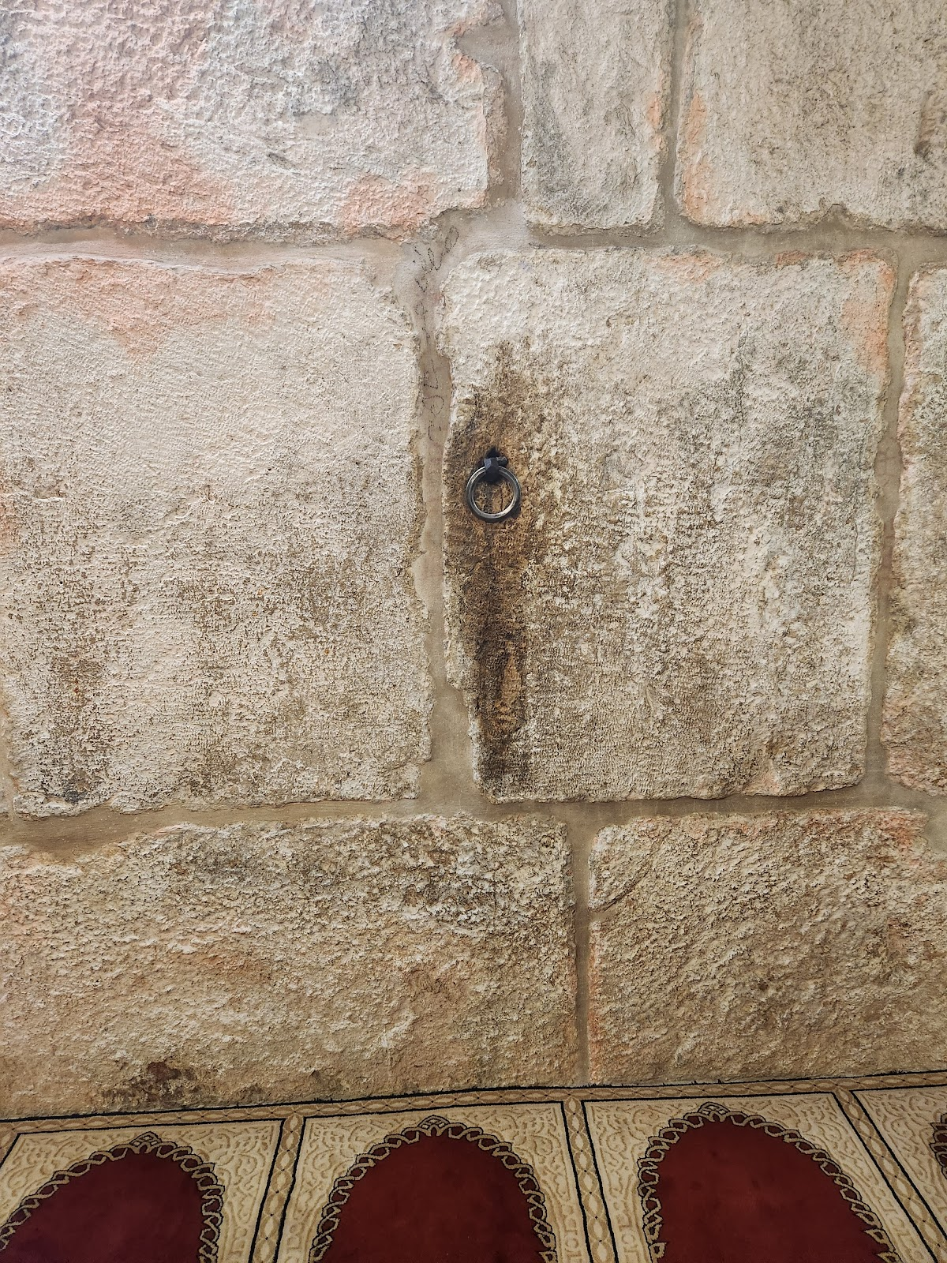
Costs:
Anas (ra) relates that the Prophet (saw) said, “I was brought the Buraq, a tall white beast, bigger than a donkey, smaller than a mule. It could place his hooves at the farthest boundary of his gaze. I mounted it until I arrived at Bayt Al-Maqdis. I tied it at the ring where the Prophets tied it before (i.e. Buraq Wall or the Western Wall). I entered Masjid Al-Aqsa Sanctuary and prayed 2 rak’ah there…

Slide 10
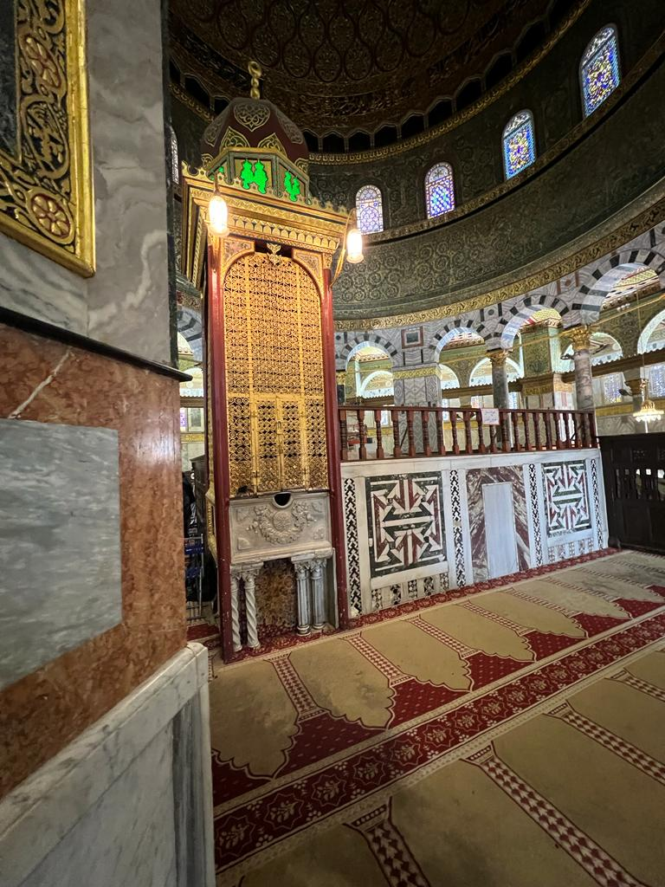
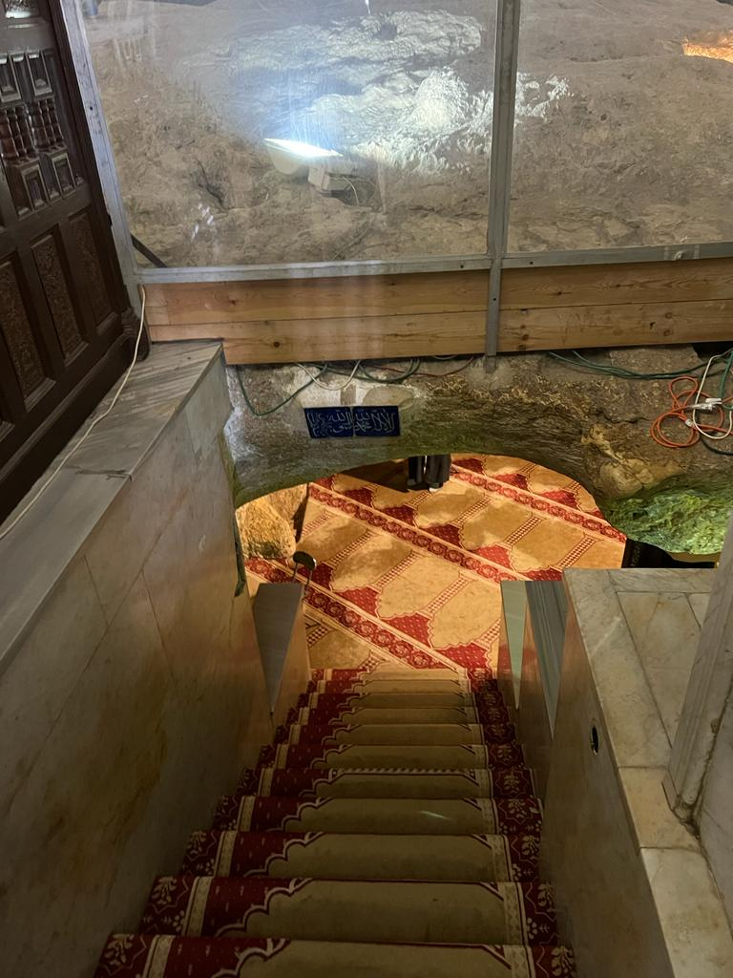

Slide 11
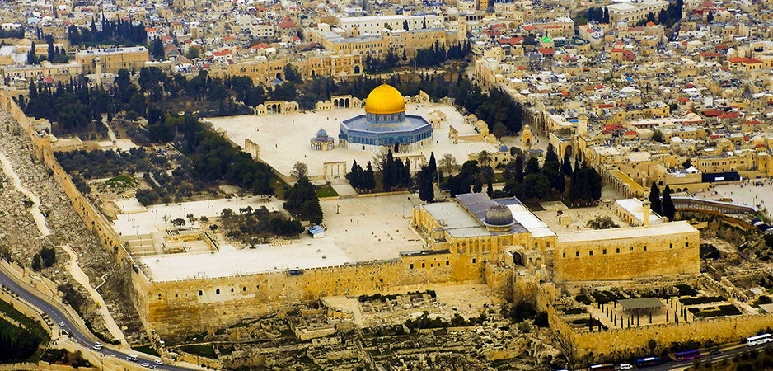

Slide 12
Prophet ISA

Slide 13
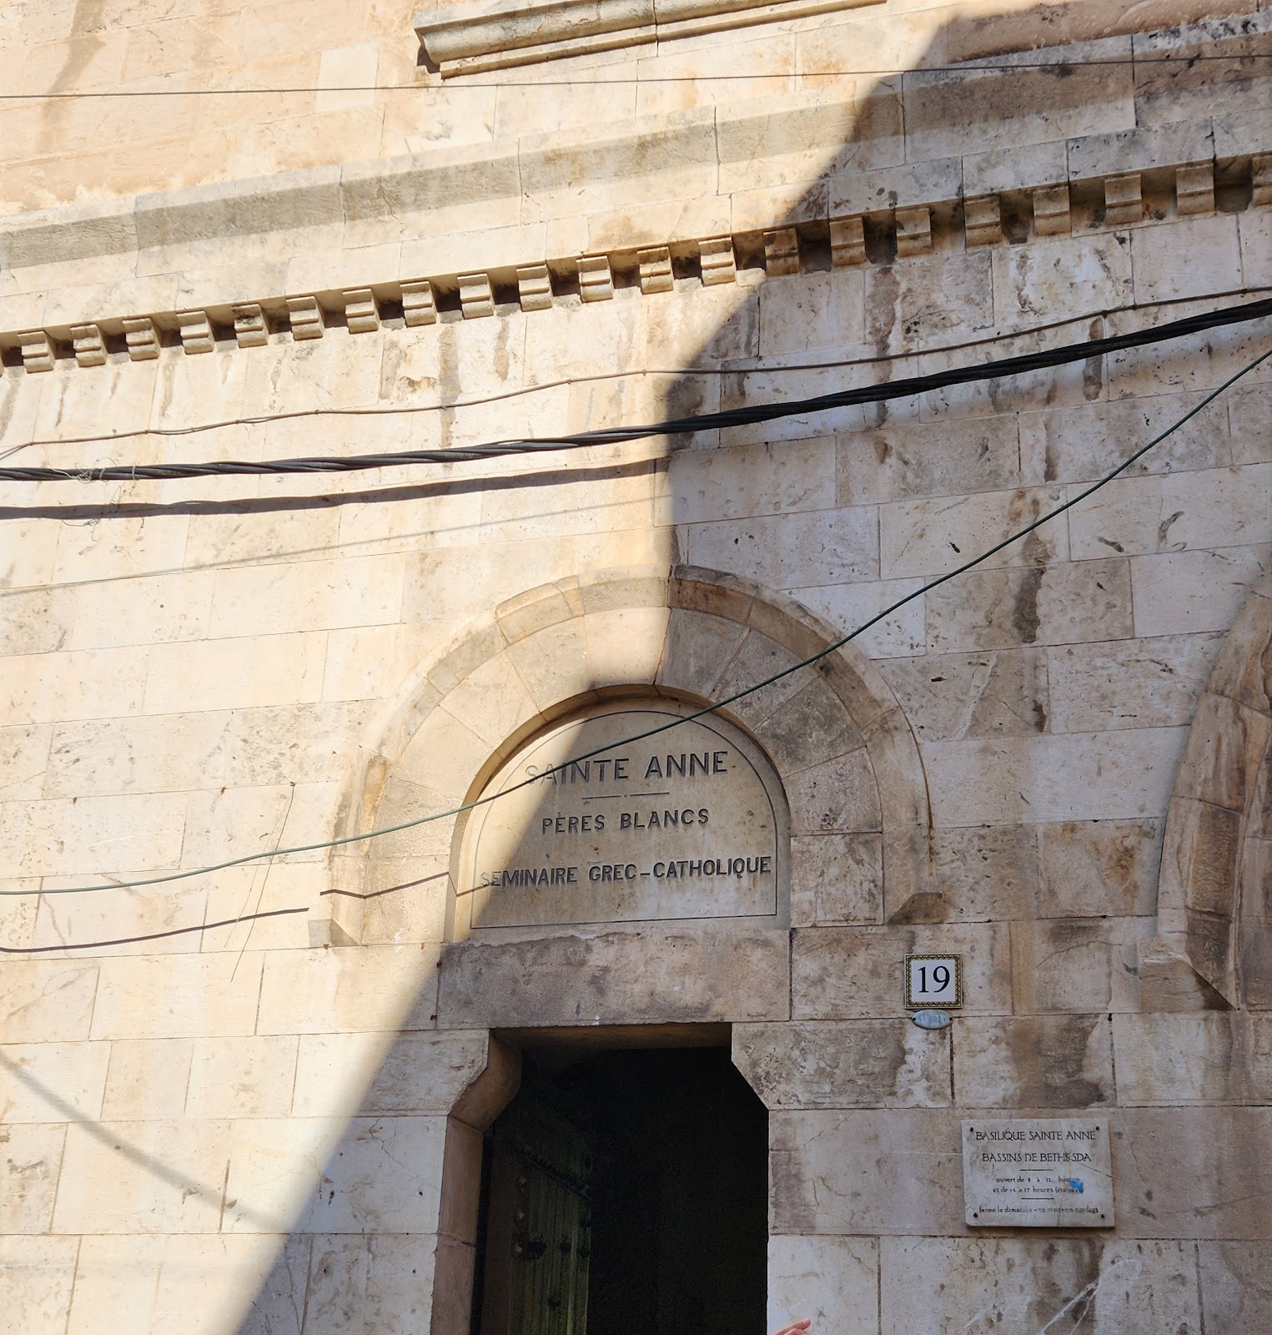
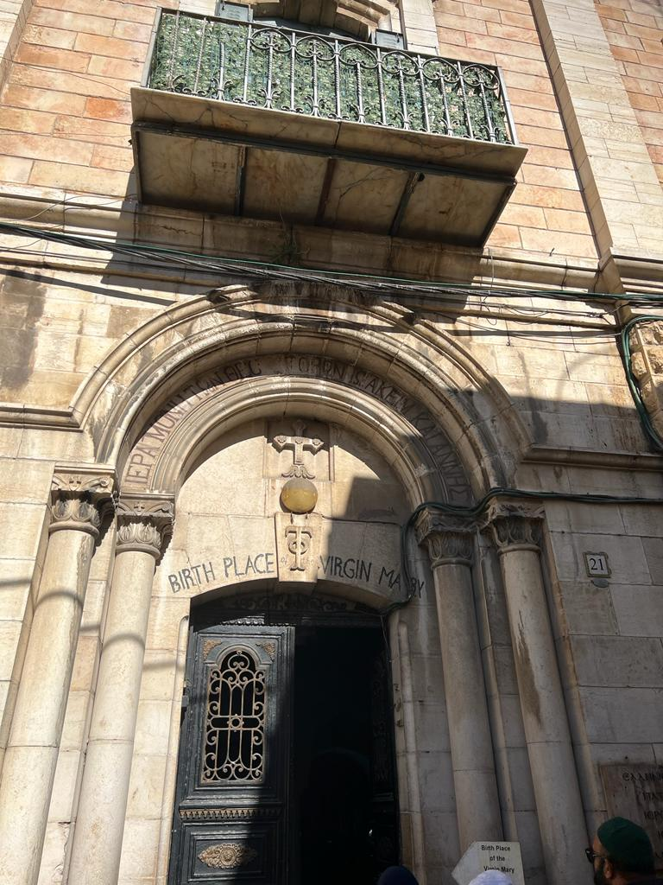

Slide 14
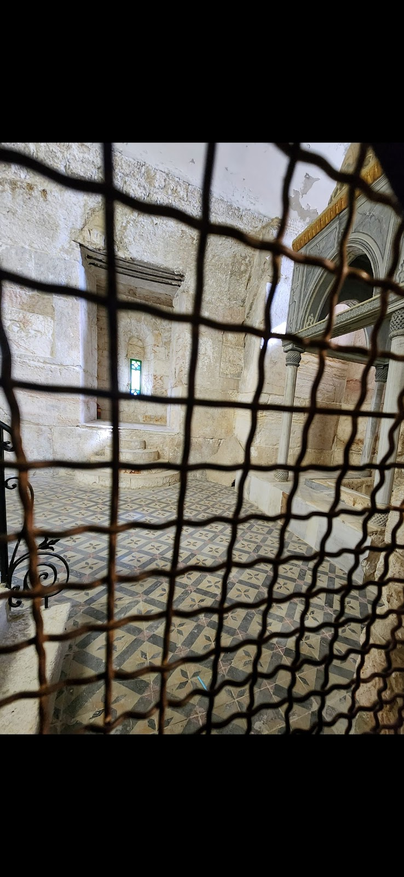
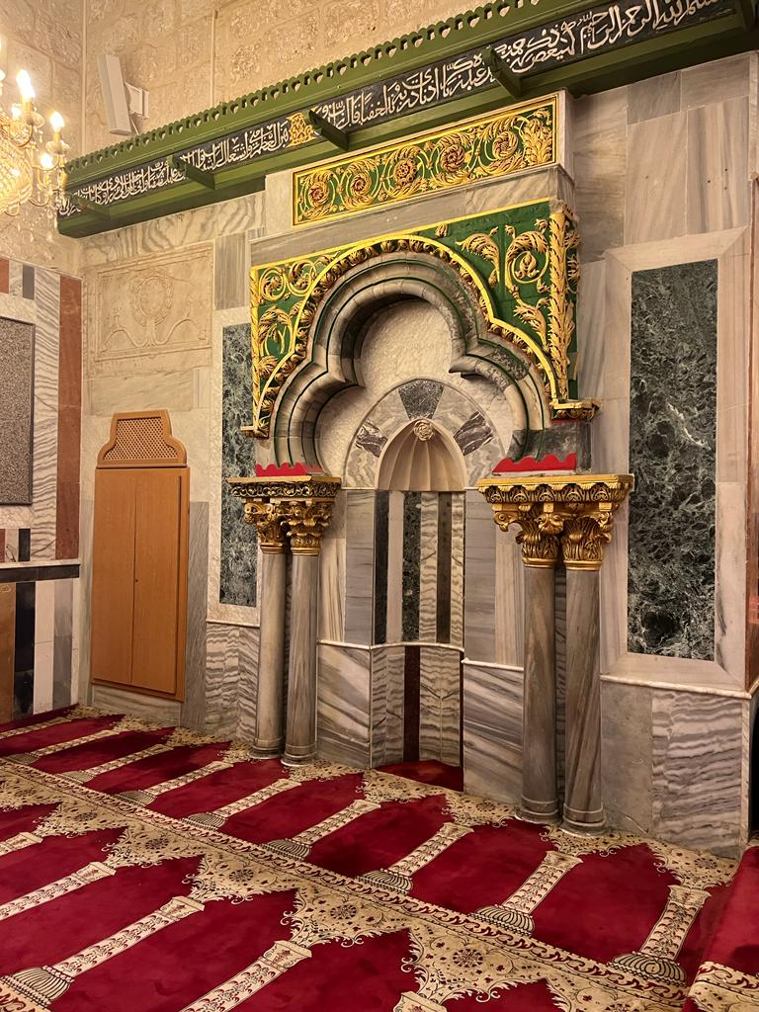

Slide 15
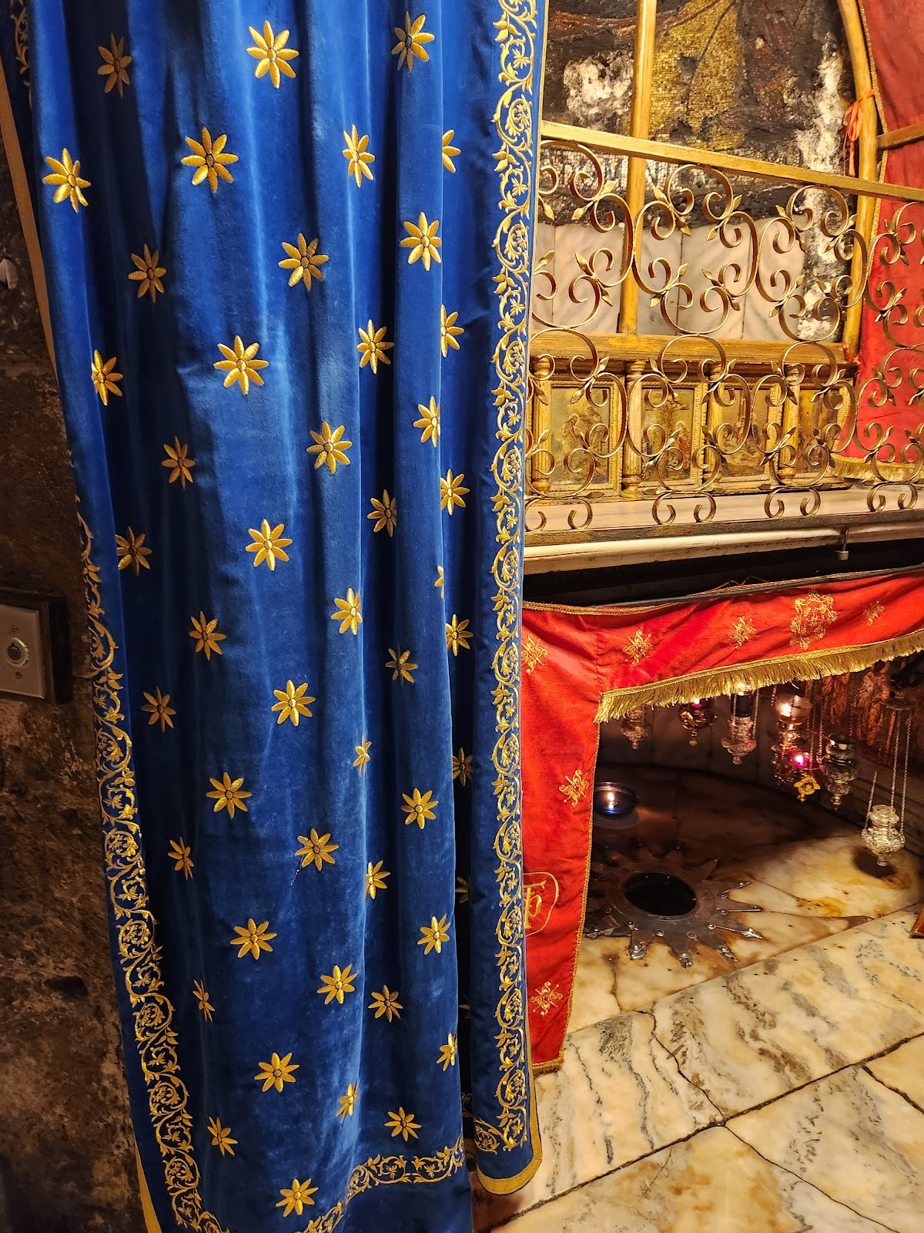
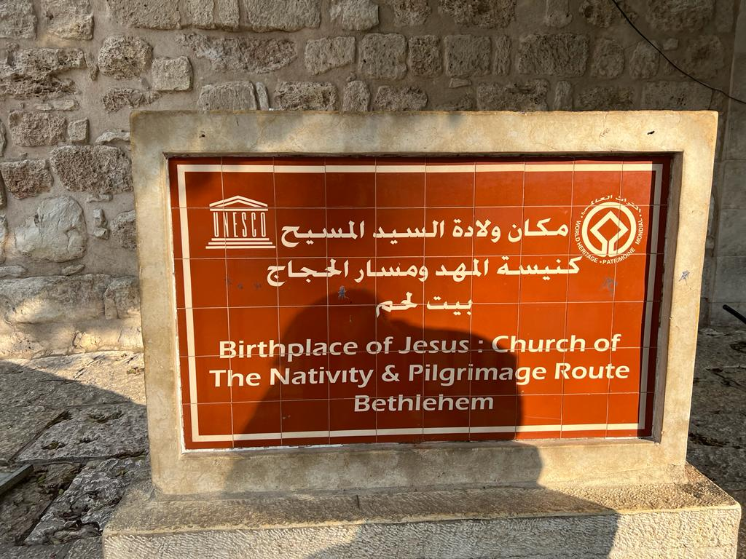

Slide 16
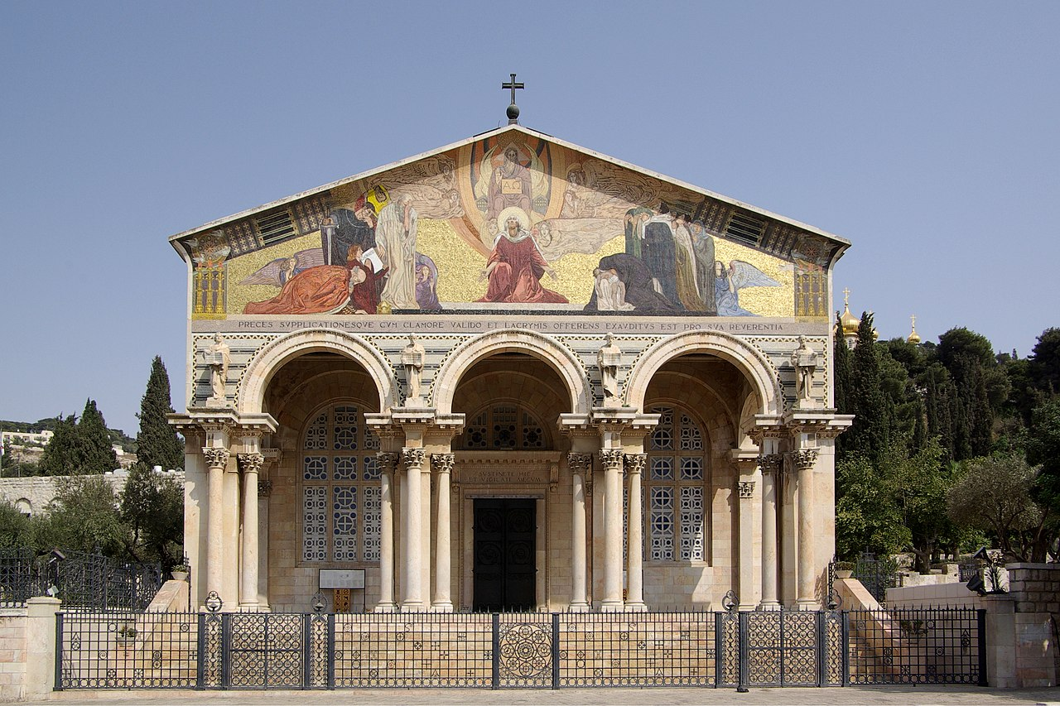
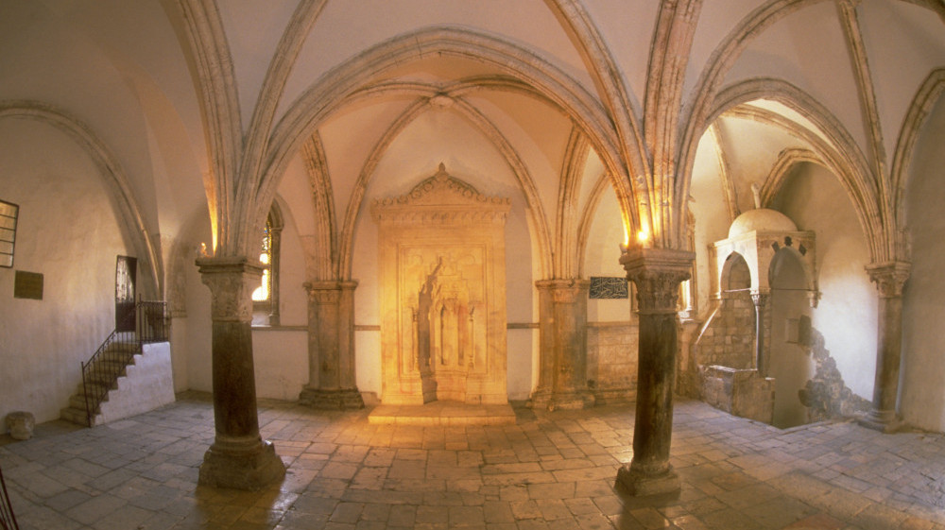

Slide 17
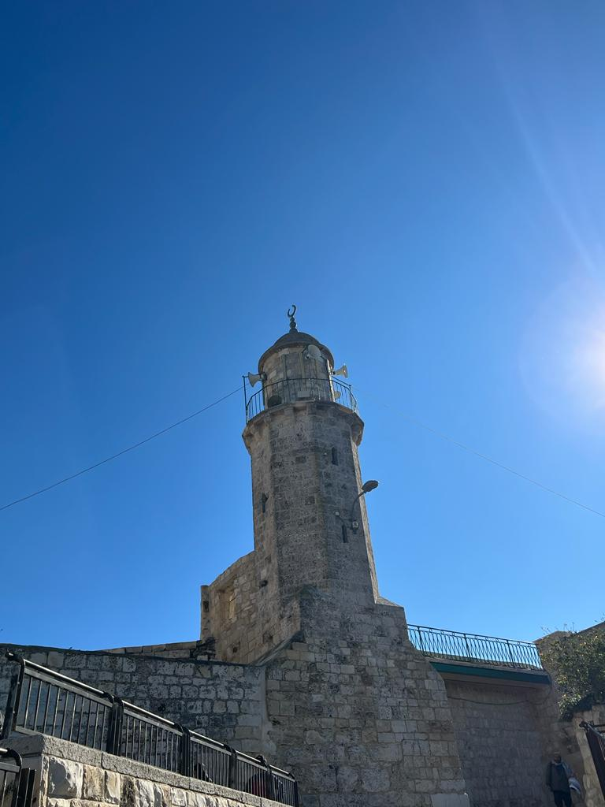
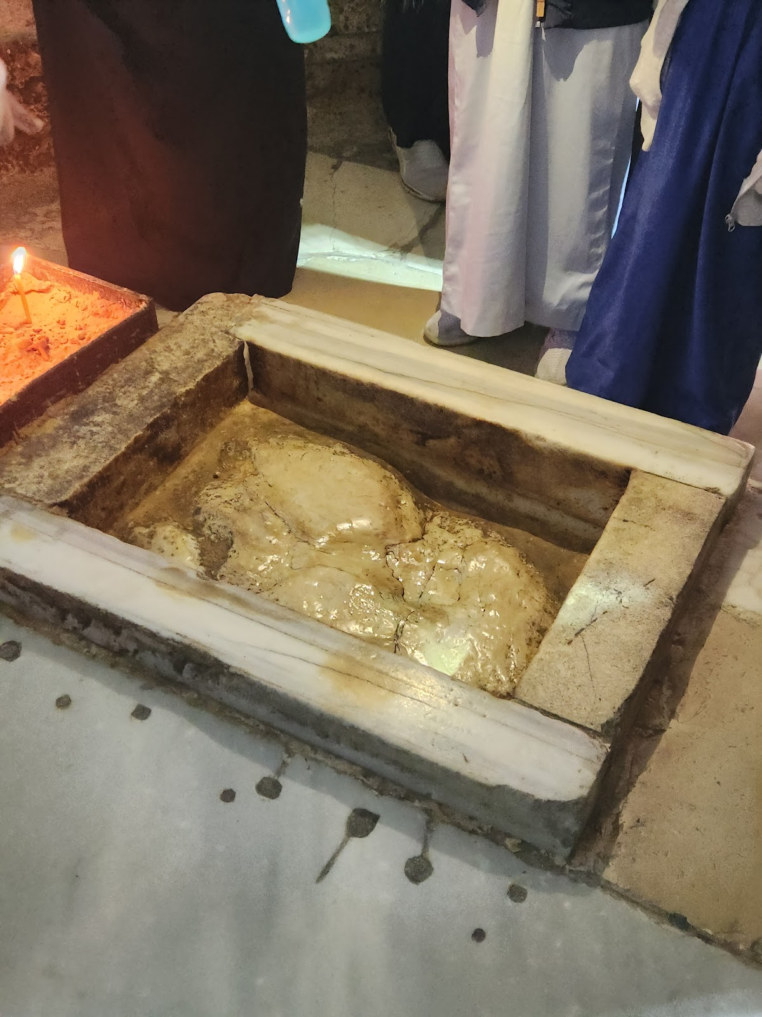
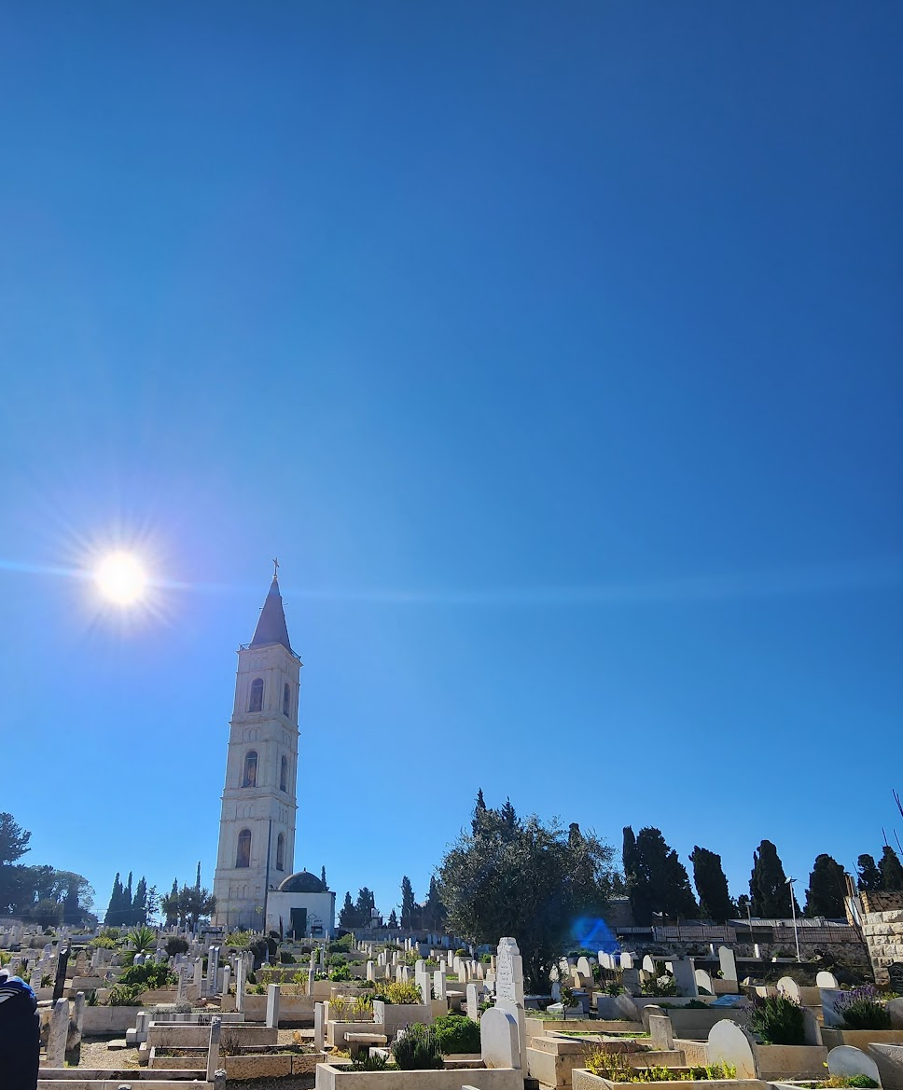

Slide 18
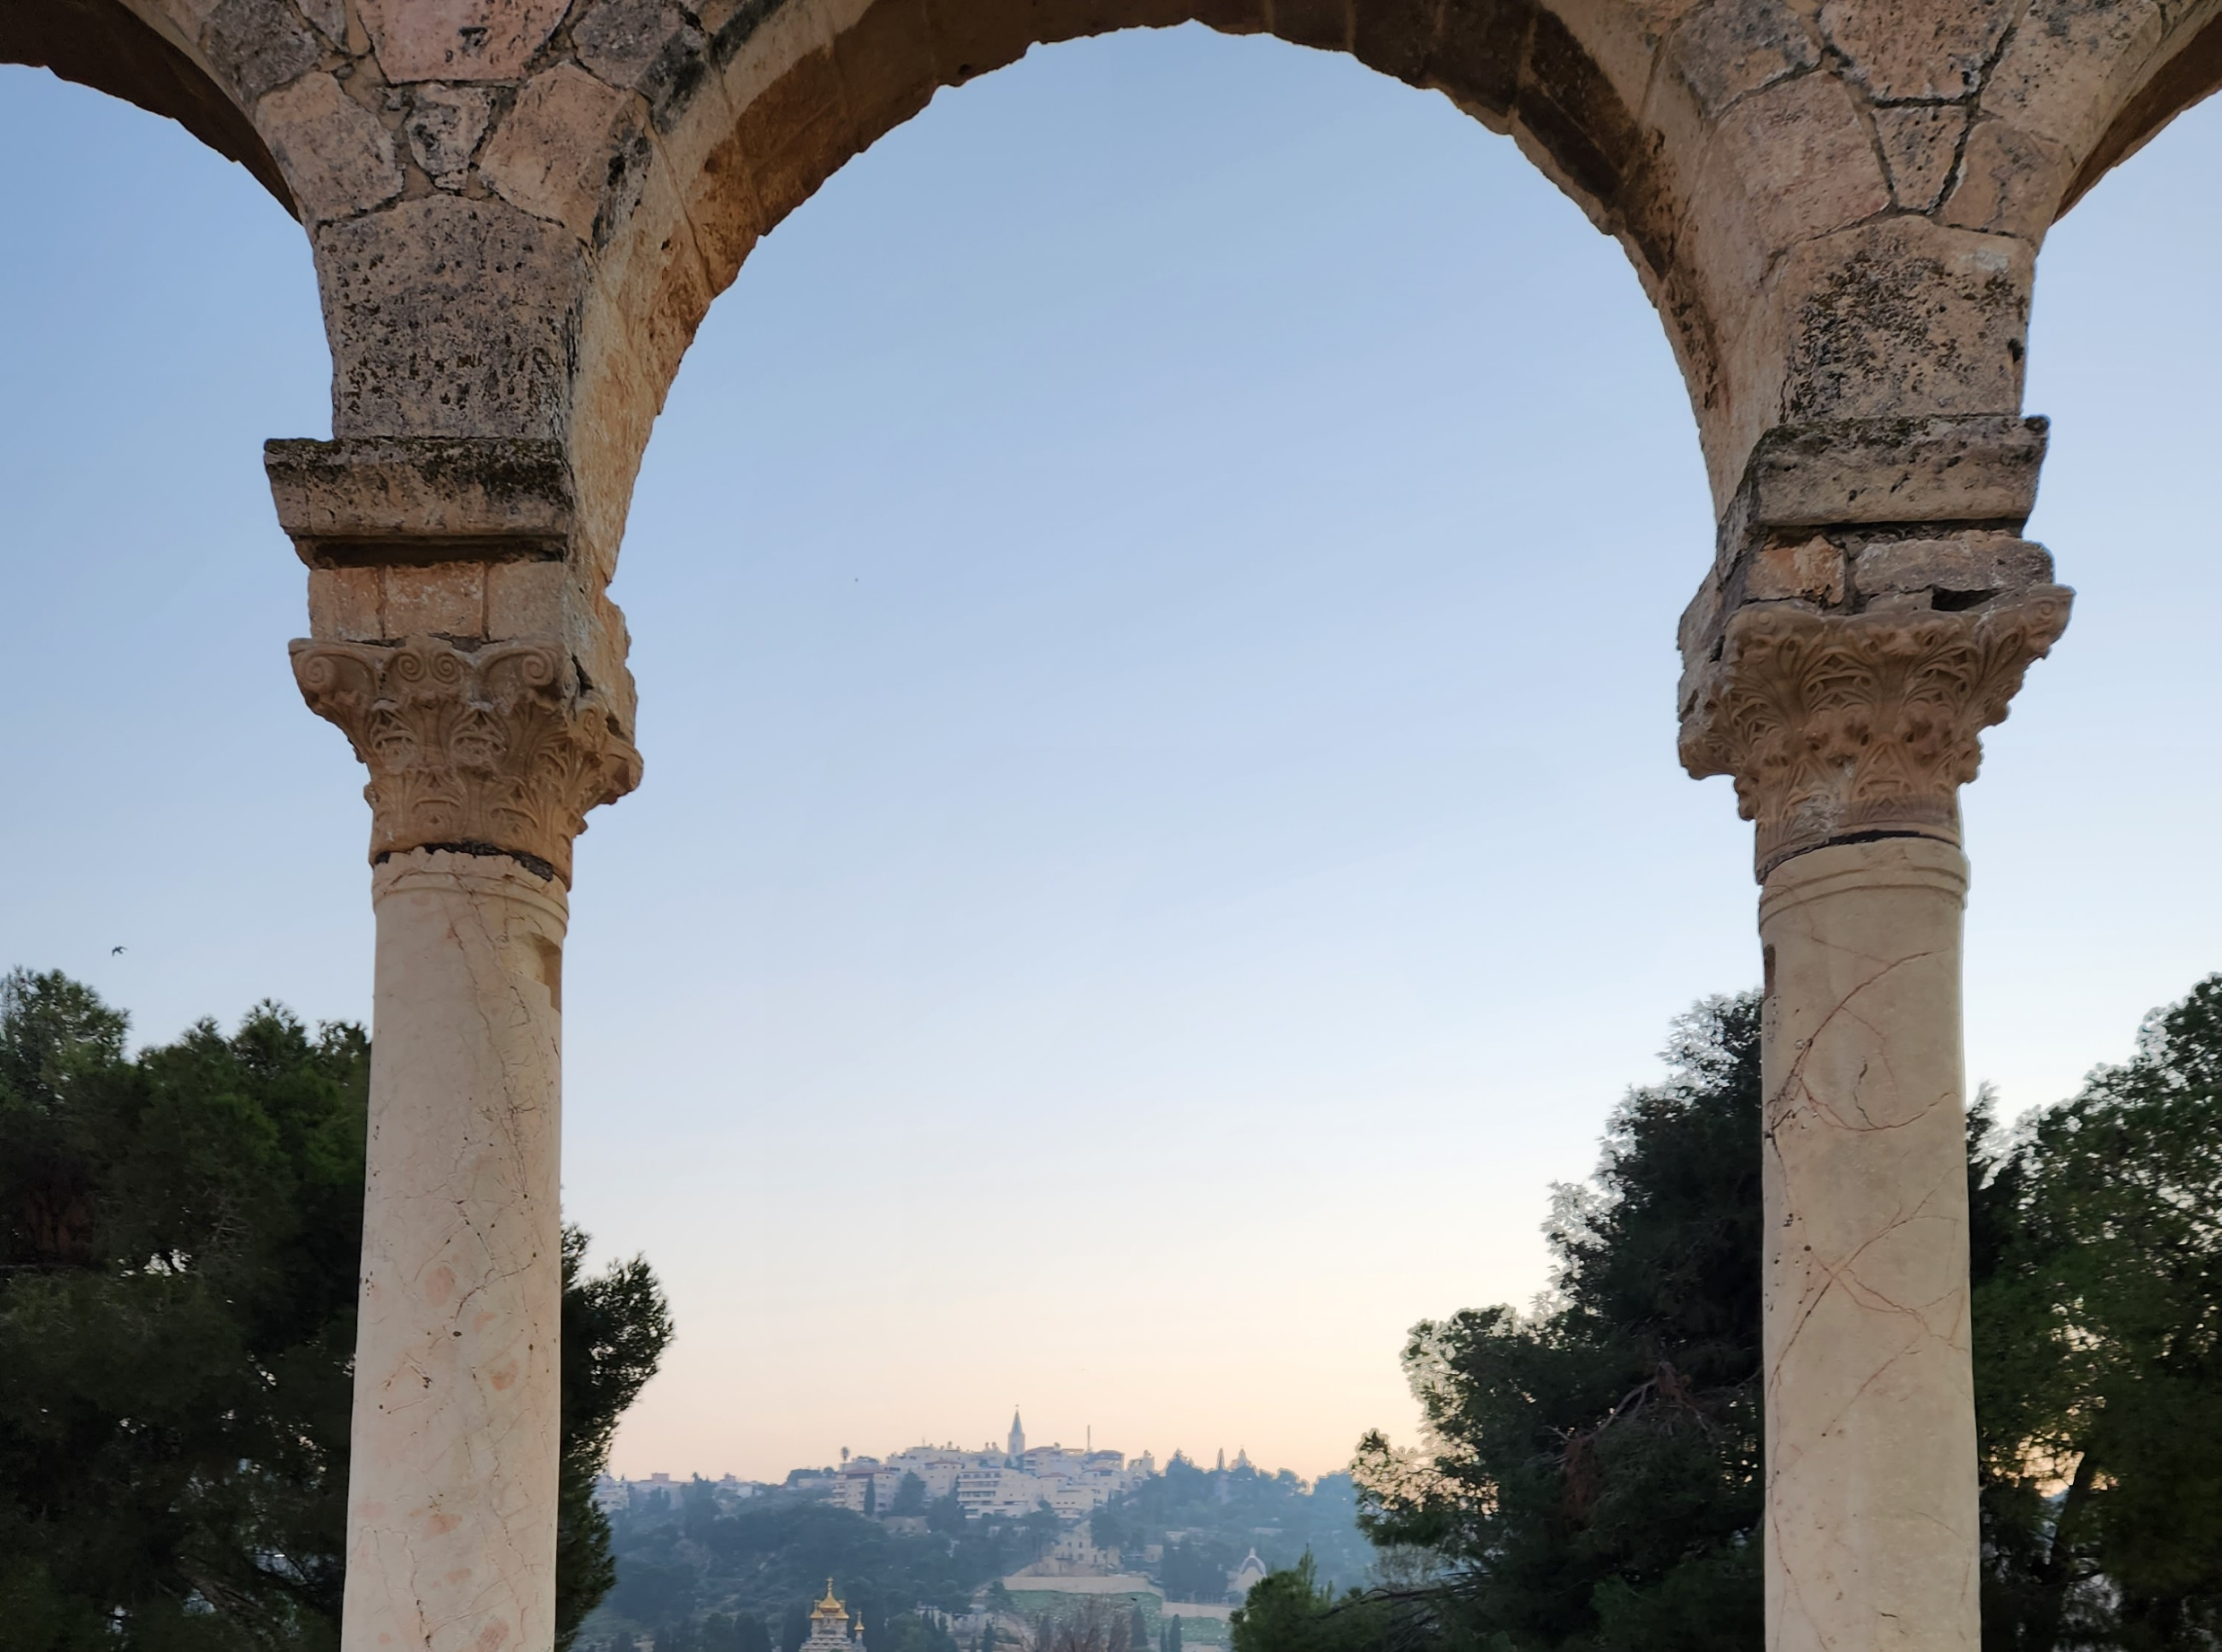
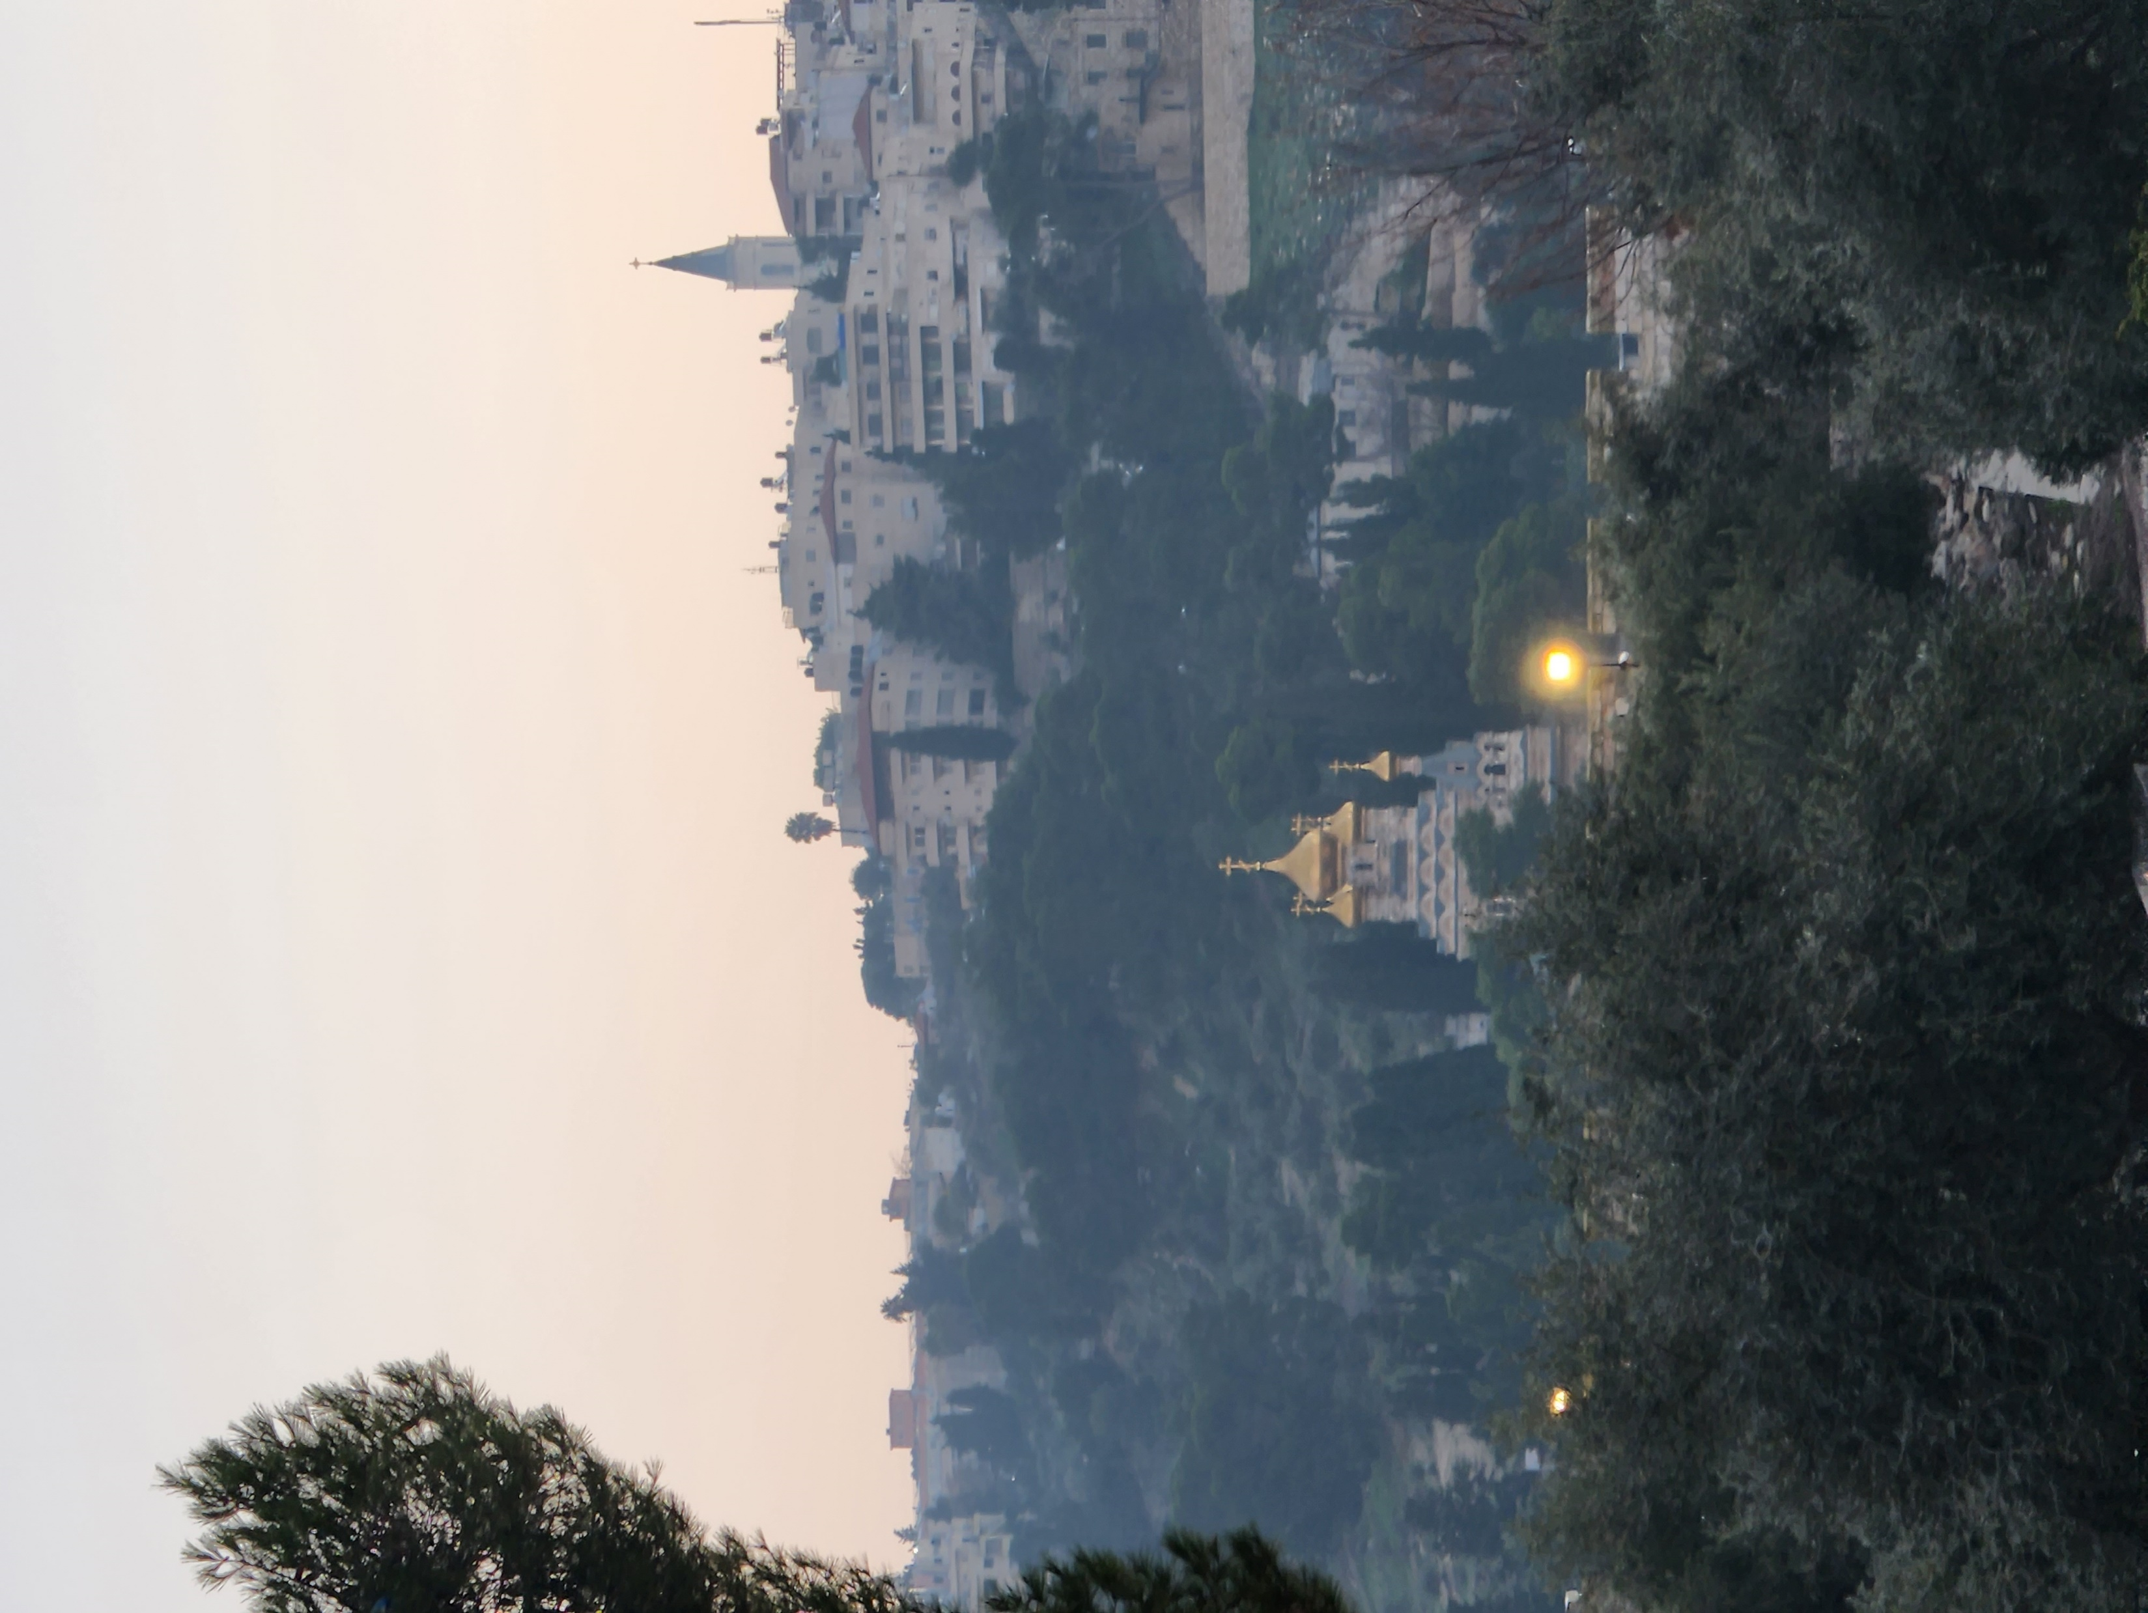

Slide 19
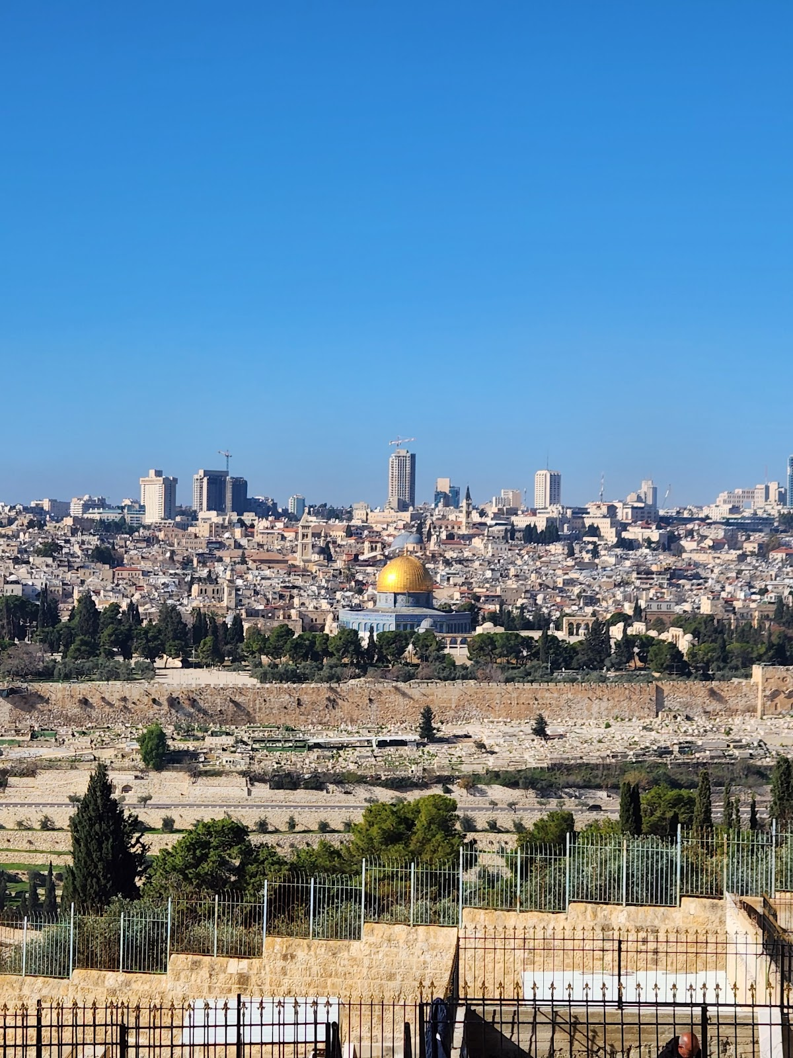
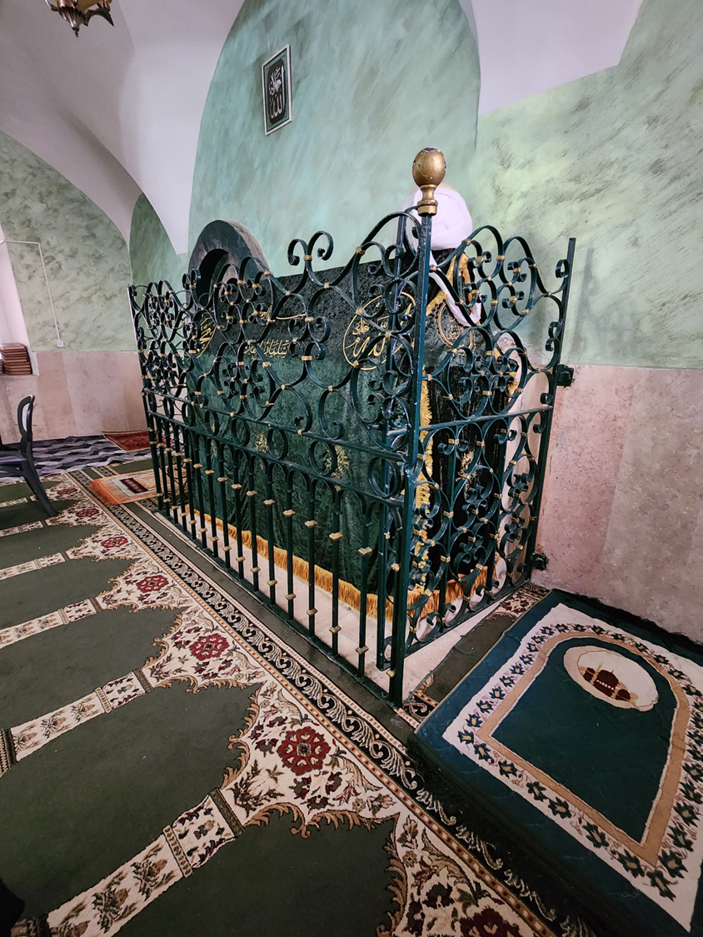

Slide 20
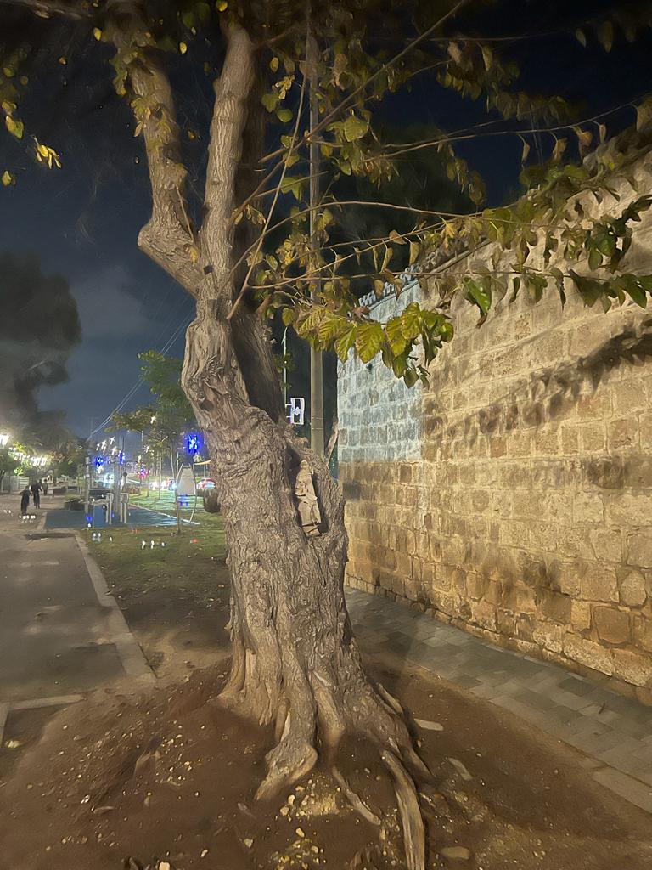
Mujamma Ibn Al-Harith (ra) narrates that the Prophet (saw) said, “Ibn Maryam (Jesus) will kill Al-Dajjal (the Anti-Christ) at the door of Ludd (a town in Palestine)”. (Ahmad, Tirmidhi)

Slide 21
Dawood and Sulaiman AS

Slide 22
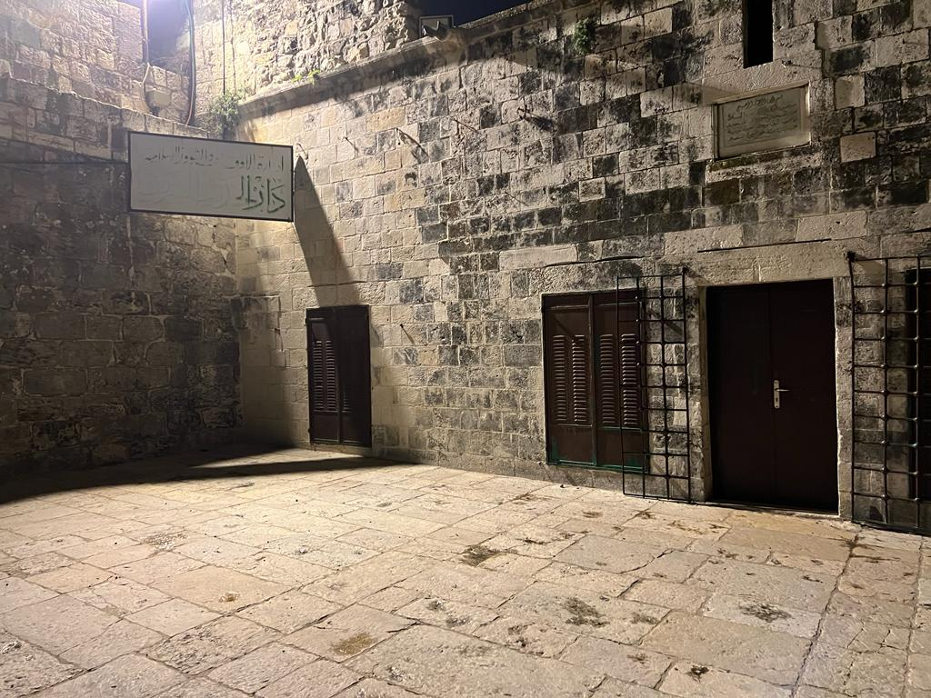
The Location of the Throne of Sulaiman AS
He built the Masjid with the help of the locals and the Jinns
When Prophet Sulaiman was building Masjid al-Aqsa, he made a du'a to Allah for three things:
First, he asked to pass verdicts which are pleasing to Allah
Second, he asked for a kingdom such that no one before or after him would have.
Third, Non should come to this Masjid except that their sins are forgiven just as the day their mother gave birth to them

Slide 23
Ibrahim AS and His Progeny
Hebron

Slide 24
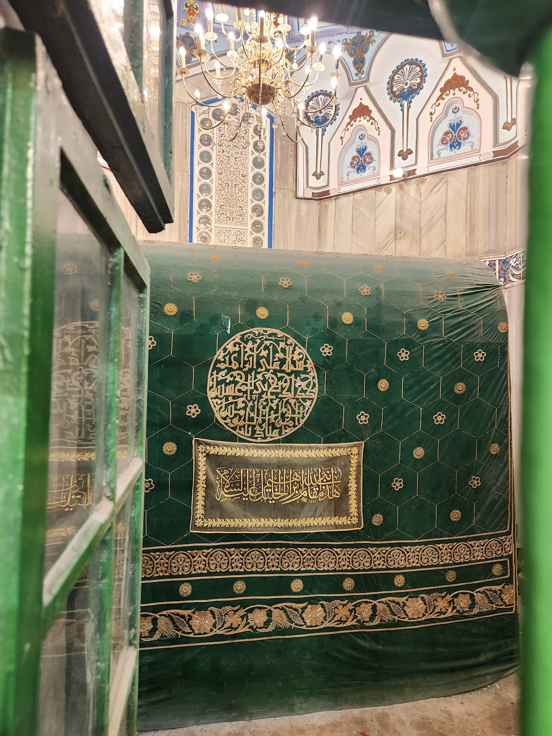
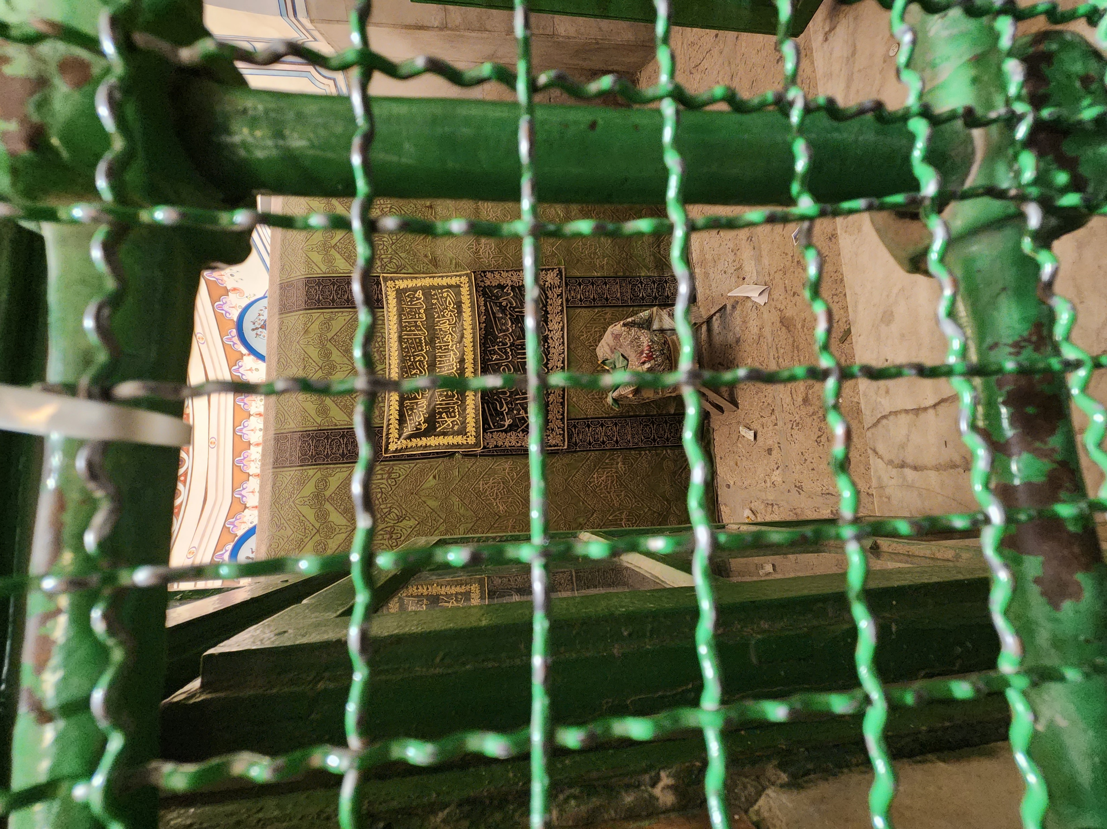
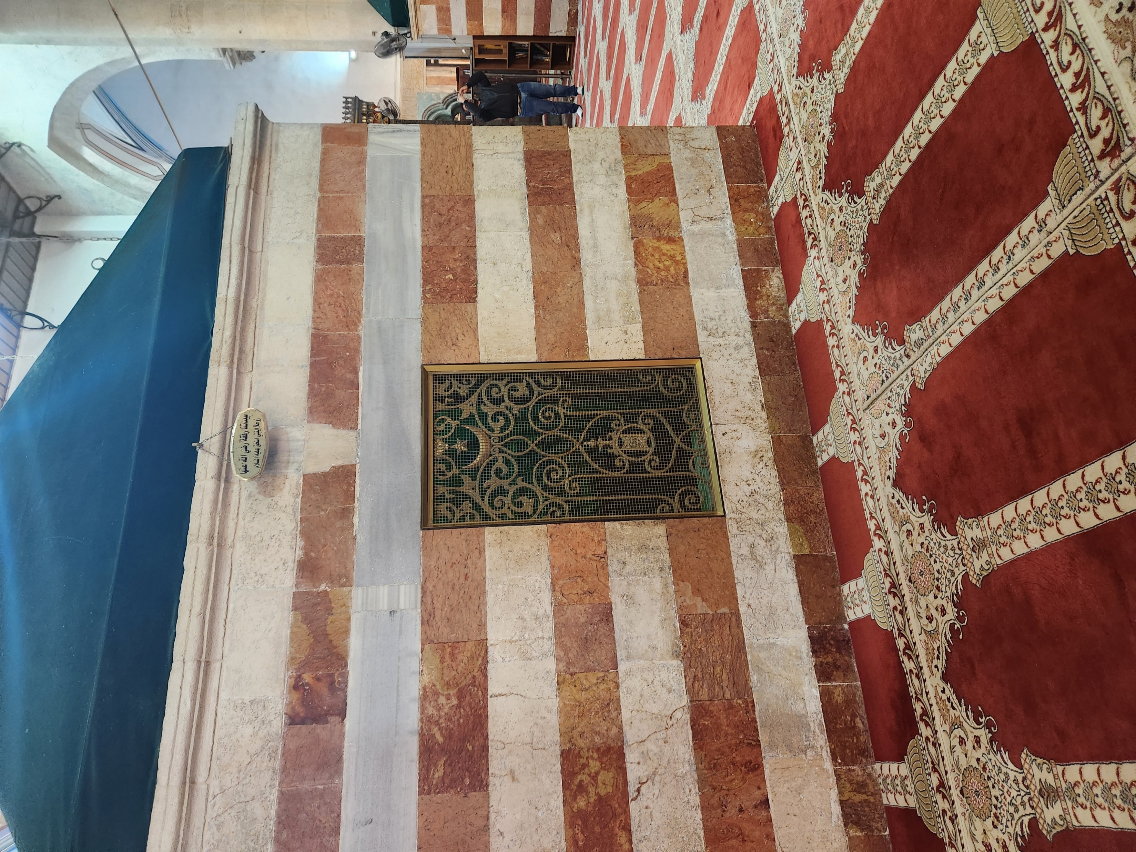

Slide 25
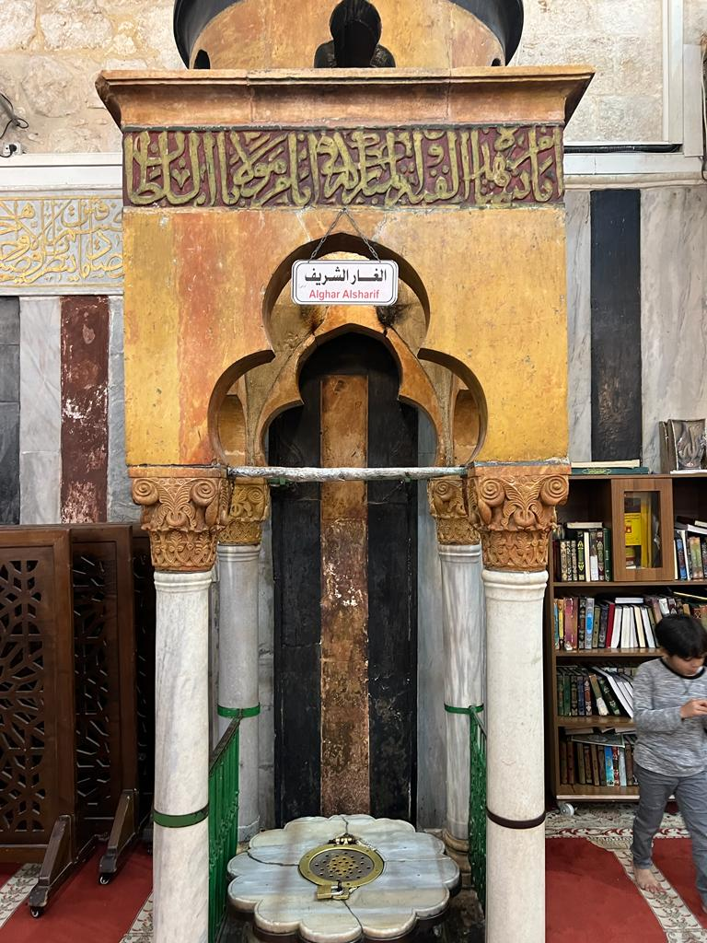
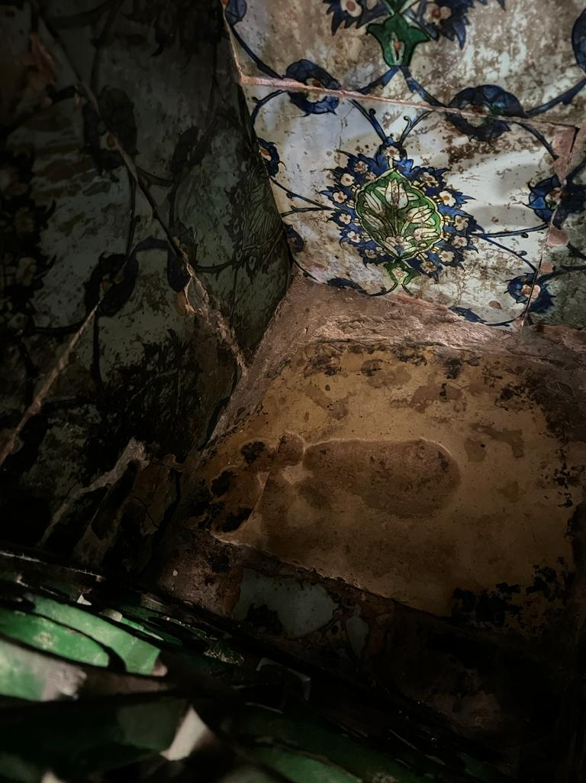

Slide 26
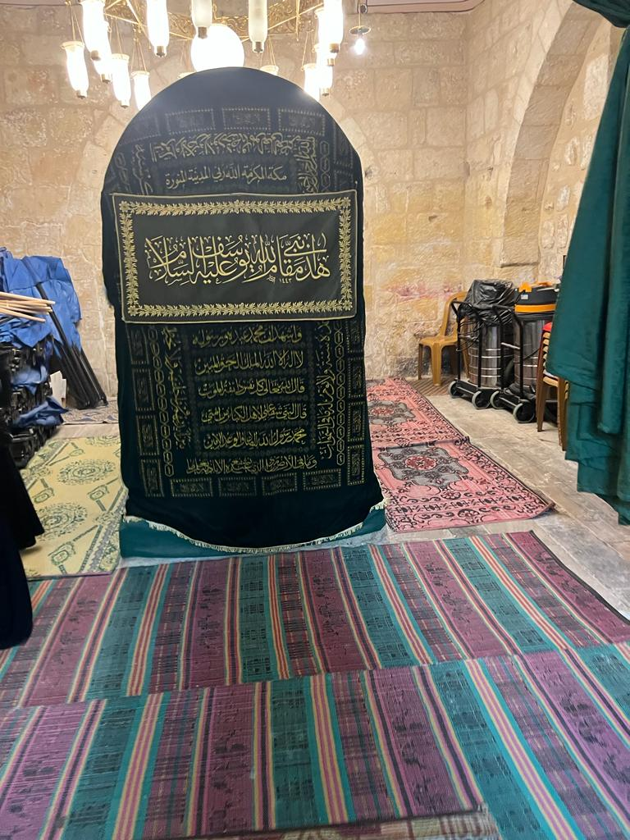
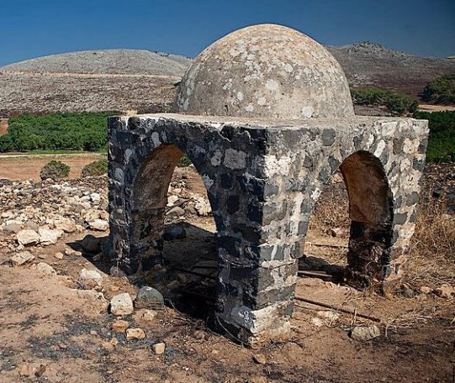

Slide 27
Yunus AS
Halhoul

Slide 28
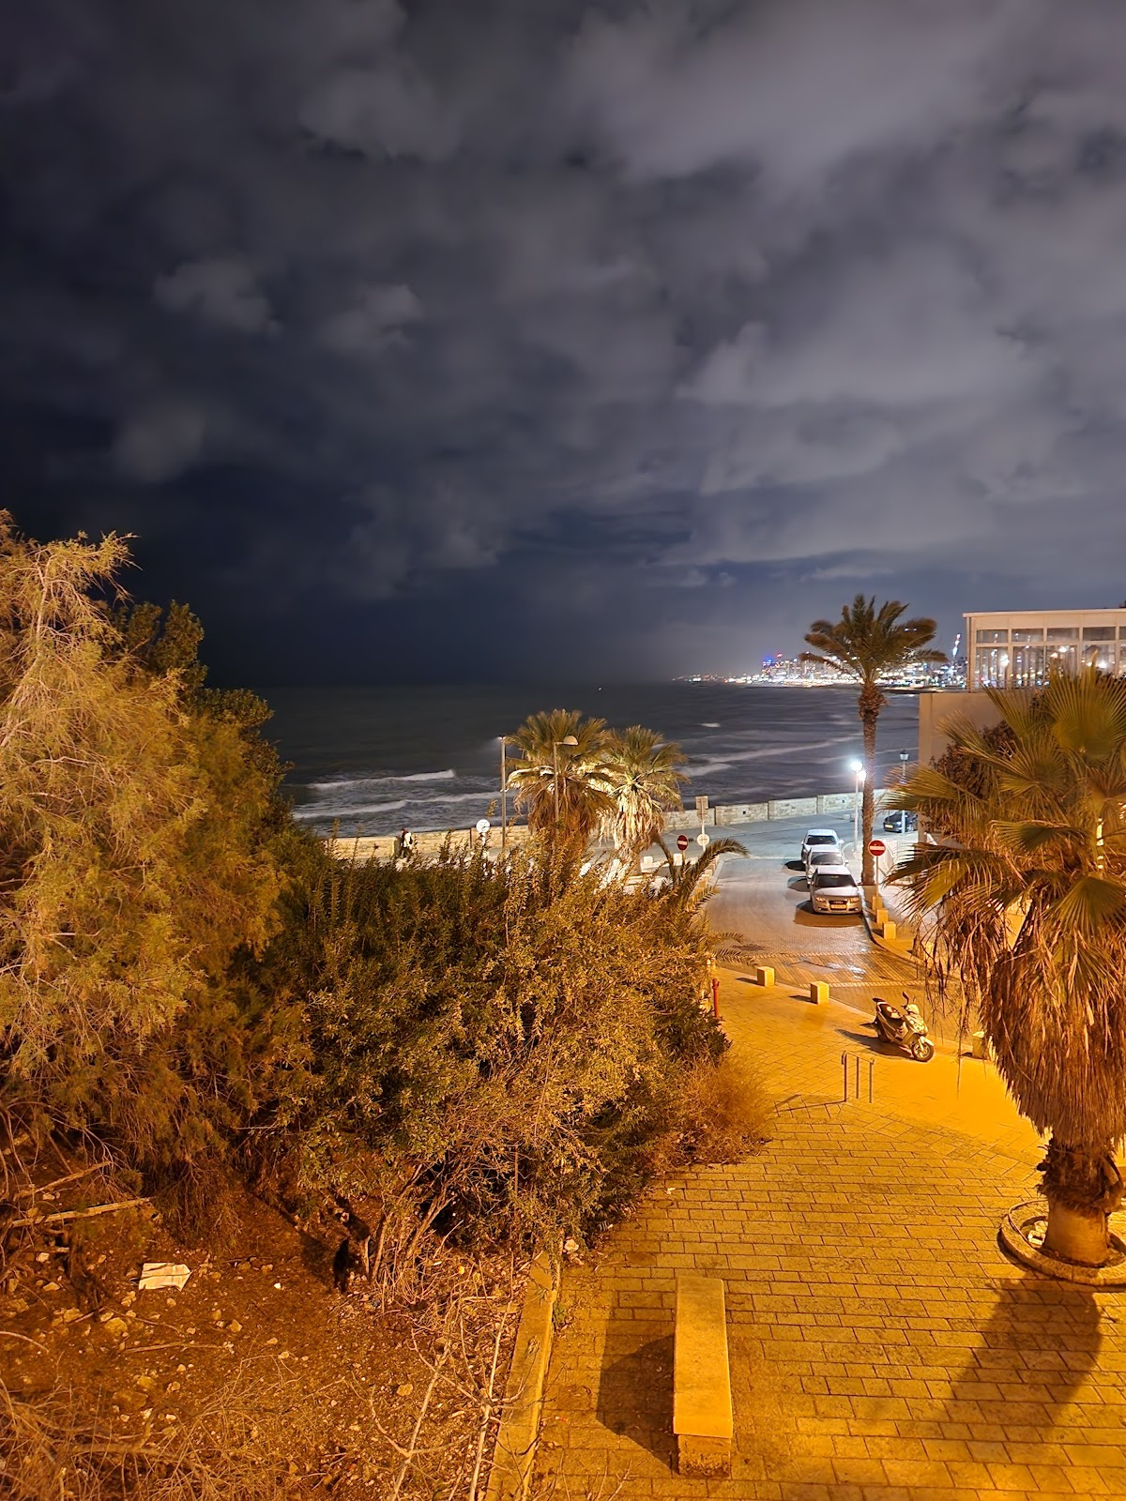
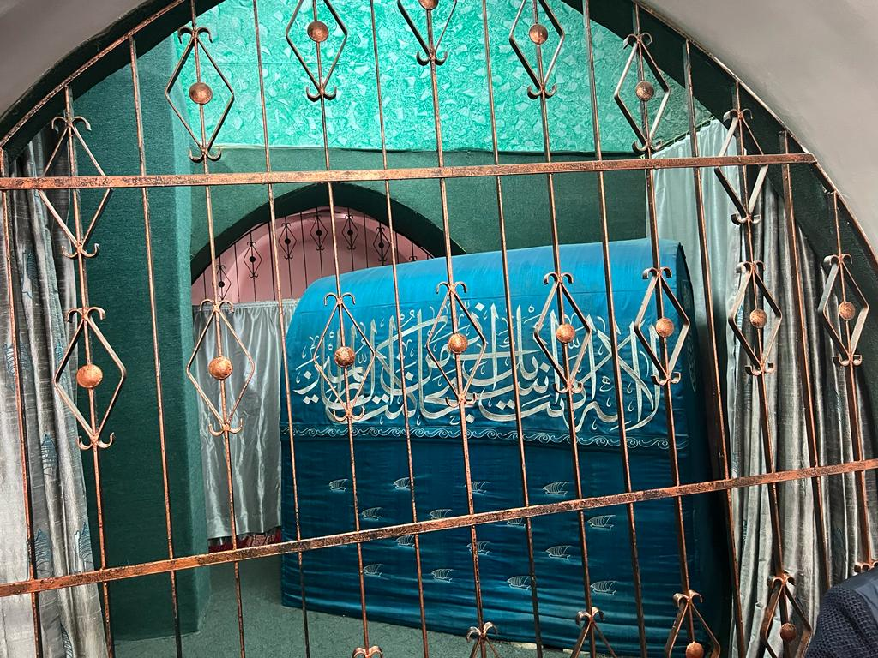

Slide 29
Musa AS
Jericho

Slide 30
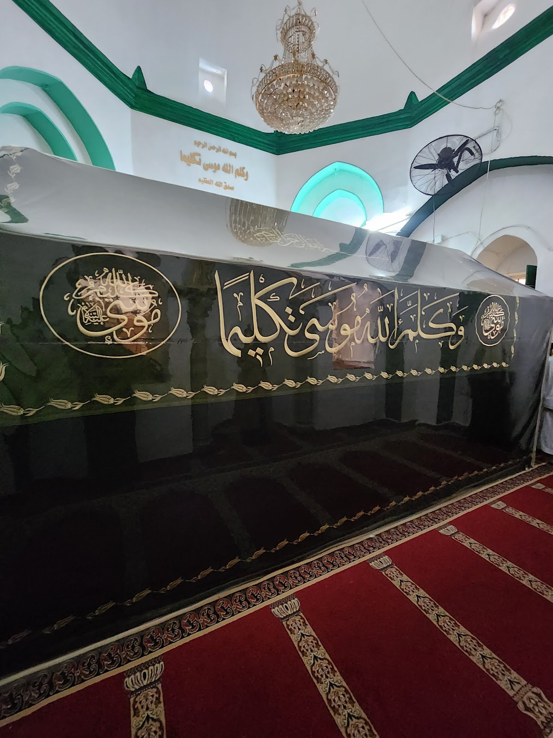
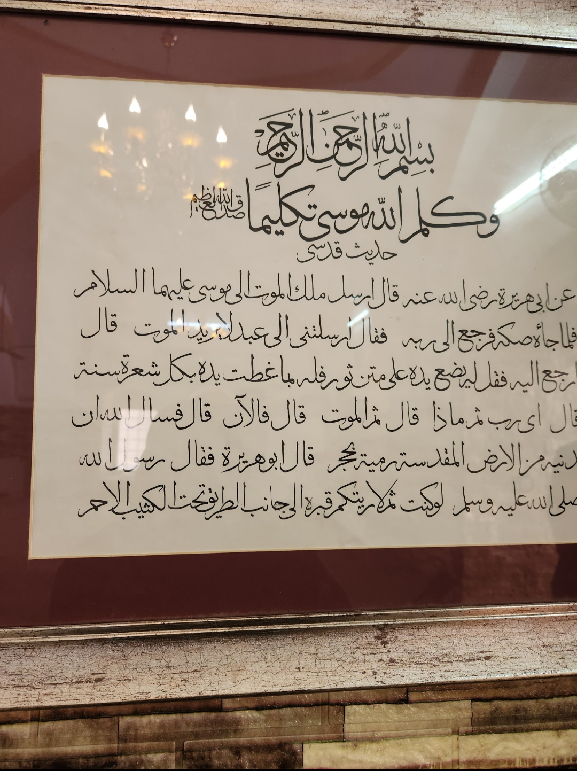

Slide 31
Islamic Conquest under Umar RA

Slide 32
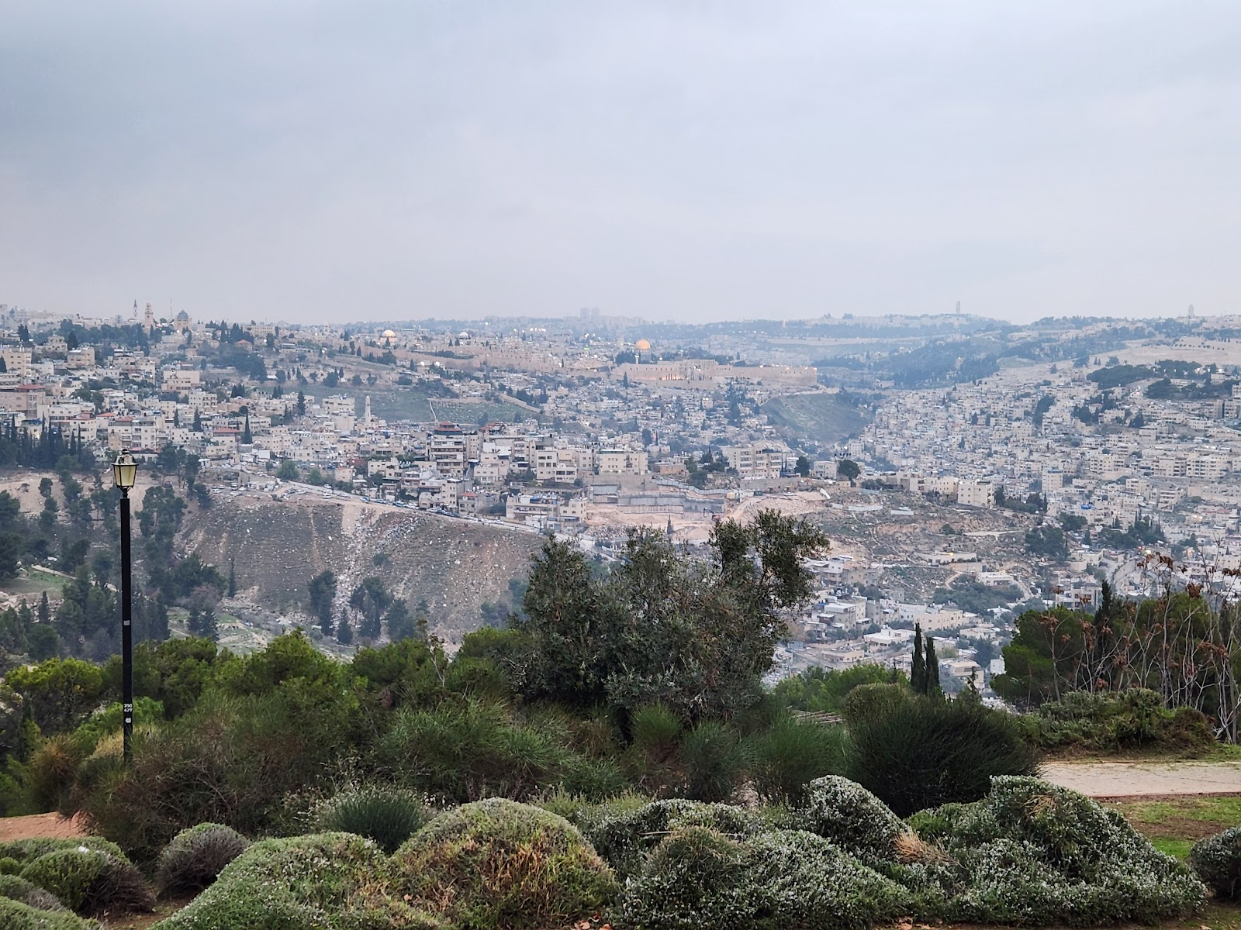
When entering Palestine, Hadhrat Umar was walking and his servant was riding his
donkey. A few points of the treaty are as follows:
1. All the inhabitants were granted security.
2. Their churches were not to be demolished nor be taken as residence.
3. Nothing shall be damaged and crosses were not to be removed.
4. They shall not be harassed because of their religion and none of them shall be harmed.
➢ From this we see Islam is a religion of tolerance and peace.

Slide 33
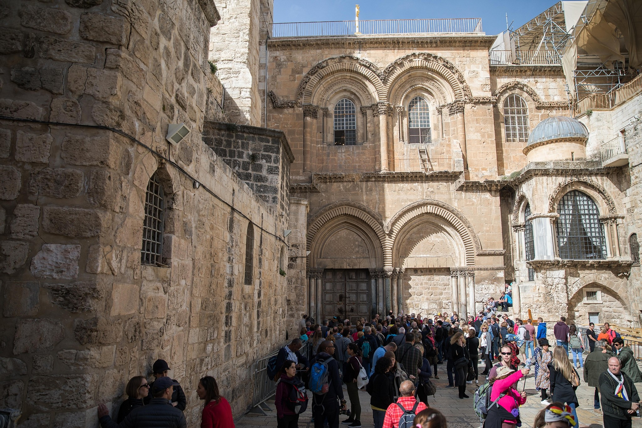
Upon entering Hadhrat ‘Umar was led to the church of the Holy Sepulchre. The Patriarch asked him to pray there but he denied fearing that he would set a precedent the threatened the continued use of it as a church

Slide 34
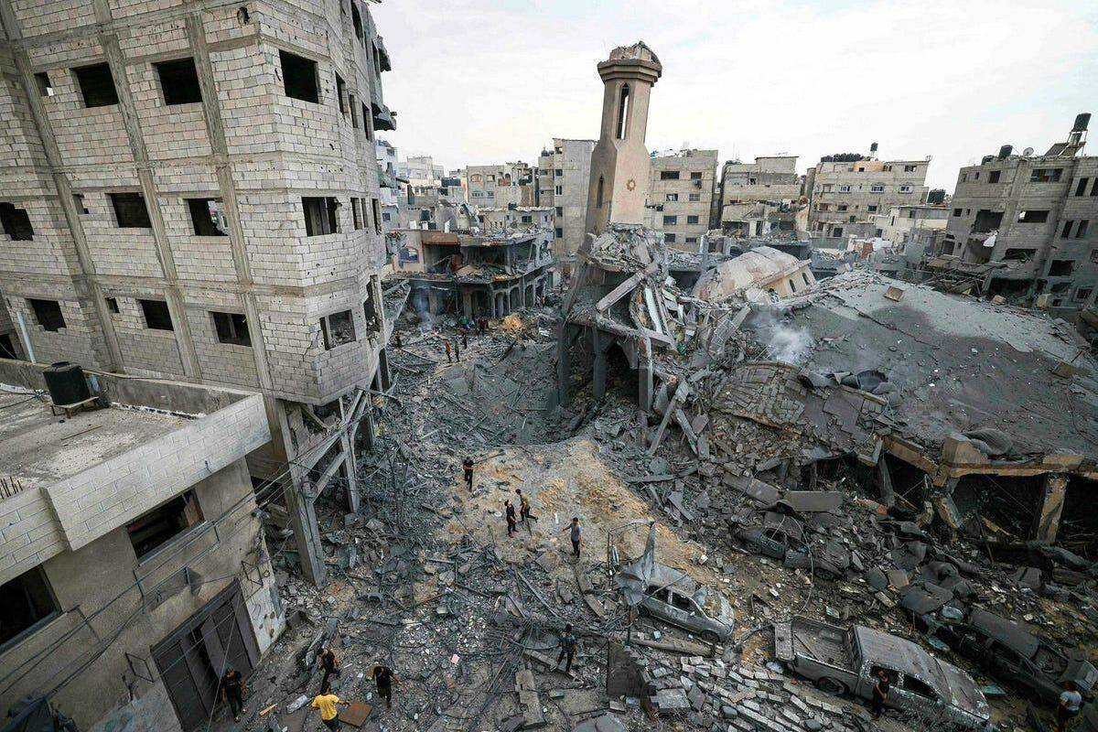
Abu Hurayrah (ra) relates that the Prophet (saw) said, “A group of my Ummah will not cease to fight at the gates of Damascus and at the gates of Al-Quds (Jerusalem) and its surroundings. The betrayal or desertion of whoever deserts them will not harm them in the least. They will remain victorious, standing for the truth, until the Final Hour rises”. (Tabarani)

Slide 35
A Brief History of Palestine/Al-Masjid Al-Aqsa:
4CE
Palestine was ruled by the Romans. Thereafter, the Byzantines conquered this Holy City. At that time, it was known as ‘Ilya.
16AH
Jerusalem came in the hands of the Muslims under Umar RA
For nearly 500 years Jerusalem remained in the hands of the Muslims.
1095
Crusaders started their Holy War in 1095. In 1099 they managed to enter Jerusalem.
Upon entering thousands were killed. The City stayed in the hands of the Christians for approximately 90 years.

Slide 36
A Brief History of Palestine/Al-Masjid Al-Aqsa:
1918
The Ottoman Empire collapsed and from 1920 till 1948 Palestine was ruled under a British Mandate.
1947
1187
Sultan Salahuddin Ayyubi retook the Holy Land. Instead of avenging the blood of those who were slain before he took ransom from those who could afford it and forgave the rest. It stayed under Ottoman rule until the fall of the Empire.
1948
78% of historic Palestine was seized for the establishment of the state of Israel. 530 Palestinian villages were ethnically cleansed and 75% of the population fled.
the United Nations General Assembly passed a partition plan dividing the British Mandate
of Palestine in two states.

Slide 37
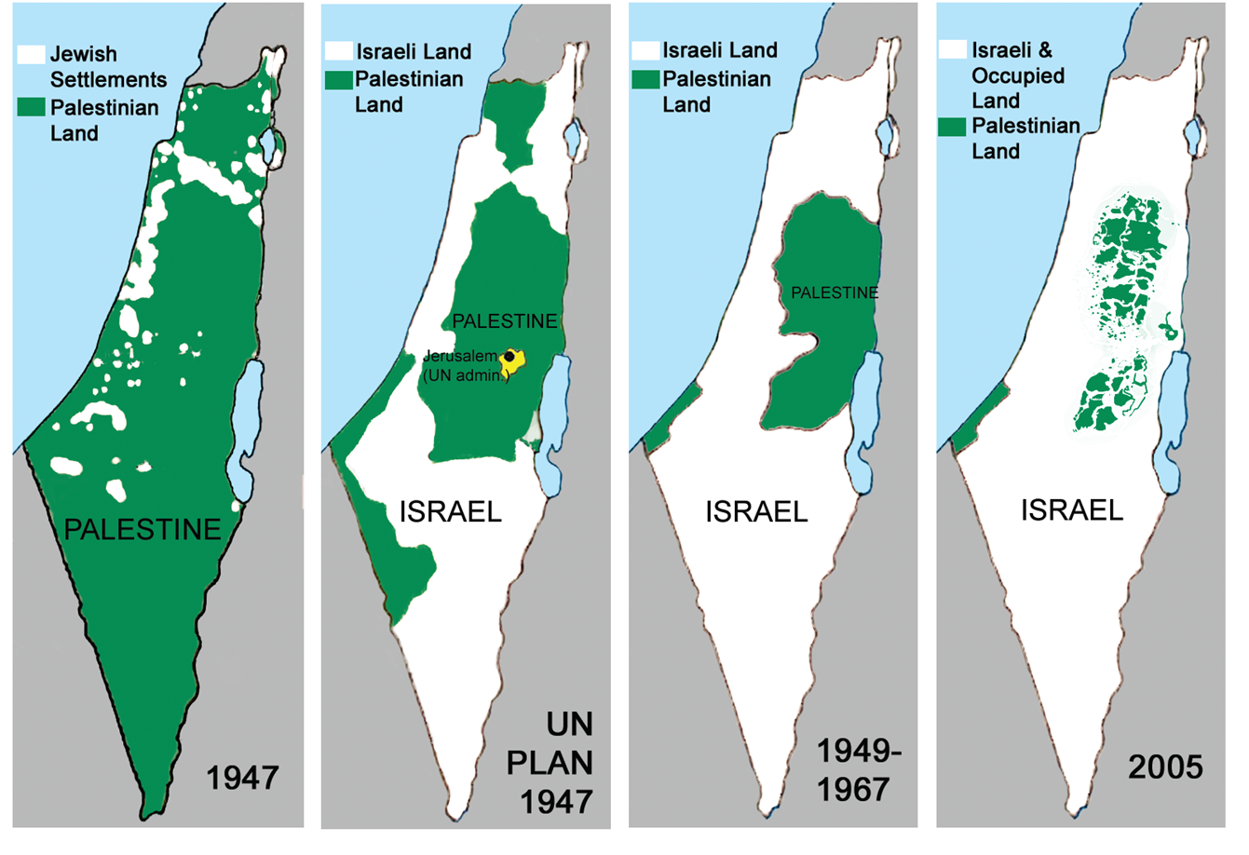

Slide 38
End of Time Hadith
The outbreak of the Great War will be at the conquest of Constantinople and the conquest of Constantinople when Al-Dajjal (Anti-Christ) comes forth”. He (the Prophet) struck his thigh with his hand and said, “This is as true as you are here or as you are sitting (meaning Muadh Ibn Jabal). (Abu Dawud)
The Messenger of Allah (saw) said regarding Al-Dajjal: “He will stay in the land forty days; he will enter every place on earth except the Ka’bah, the Prophet’s Masjid, Al-Aqsa Sanctuary and Mount Sinai”. (Ahmad)

Slide 39
What can we do
Mawlana Ashraf ‘Ali Thanwi ؒhas mentioned that Allah Ta’ala has kept the duty of protecting Masjid al-Haram upon himself. However, the condition of masjid al-Aqsa is dependent of the condition of the Muslim Ummah. If the Muslim Ummah were to be obedient to Allah, Allah would keep it in their hands. On the contrary, if the Muslim Ummah were to fall in disobedience, the disbelievers would be able to take control of the Holy Land.
The Prophet (ﷺ) said: The people will soon summon one another to attack you as people when eating invite others to share their dish. Someone asked: Will that be because of our small numbers at that time? He replied: No, you will be numerous at that time: but you will be foam/rubbish like that carried down by a sea, and Allah will remove the awe of you from the hearts of your enemy and Wahn will be placed in your heart. Someone asked: What is Wahn. Messenger of Allah He replied: Love of the world and dislike of death.

Slide 40
What to do
Spread awareness in whatever capacity we can
Salah
Istighfar and Tawbah
Sadaqah and Sending donations
Duaa
Salawat upon the Prophet
Quran Recitation
Quranic Duaas – La ilaha Illa Anta Subhanaka..

Slide 41
